Slide 1
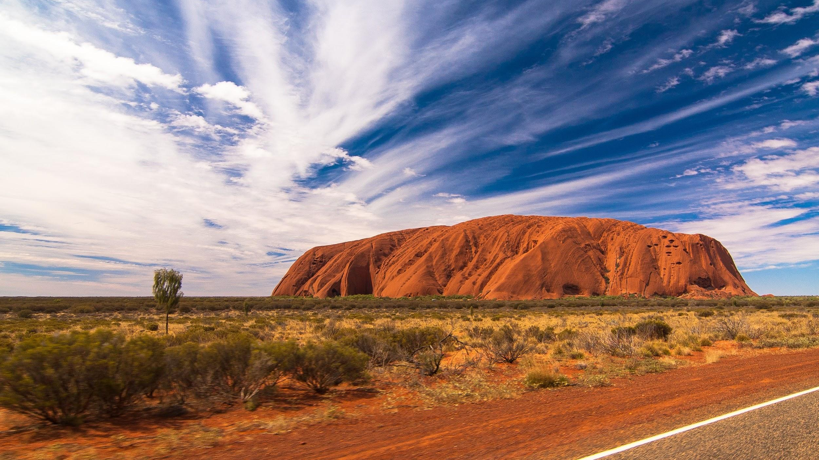
INDIGENOUS CLASSIFICATION SYSTEMS
We will compare Aboriginal and Torres Strait Islander classification systems to systems used by contemporary science.
Notes:
Insert cover image and use transparency settings to fade image.

Slide 2
Do not delete this slide.
This slide is designed so that you can copy the prompt box you need and insert it into your slides.
This slide is hidden and will not be included when presenting your lesson.
TRACK WITH ME
VOCABULARY
1 -
HINT
Students, remember….
CHECK FOR UNDERSTANDING
READ WITH ME
TEACHER CUE
MAKE THE CONNECTION
Students, you already know….
EXTENSION

Slide 3
Put the levels of classification in order using numbers 1 - 7.
NUMBER | A: Peacock | B: Emu | C: Cassowary
1 | S: Pavo cristatus | K: Animalia | O: Casuariiformes
2 | P: Chordata | F: Casuariidae | G: Casuarius
3 | K: Animalia | G: Dromaius | C: Aves
4 | O: Galliformes | O: Casuariiformes | S: Casuarius casuarius
5 | C: Aves | C: Aves | F: Casuariidae
6 | G: Pava | P: Chordata | K: Animalia
7 | F: Phasianida | S: Dromaius novaehollandiaes | P: Chordata
HINT
King KINGDOM Phillip PHYLUM Came CLASS Over ORDER For FAMILY Good GENUS Spaghetti SPECIES

Slide 4
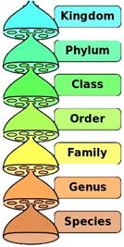
Once ordered, the organisms should be classified as follows:
NUMBER | A: Peacock | B: Emu | C: Cassowary
1 | K: Animalia | K: Animalia | K: Animalia
2 | P: Chordata | P: Chordata | P: Chordata
3 | C: Aves | C: Aves | C: Aves
4 | O: Galliformes | O: Casuariiformes | O: Casuariiformes
5 | F: Phasianida | F: Casuariidae | F: Casuariidae
6 | G: Pava | G: Dromaius | G: Casuarius
7 | S: Pavo cristatis | S: Dromaius novaehollandiaes | S: Casuarius casuarius
Which two organisms are more closely related? Justify your answer.

Slide 5
Repeat the opposite word/phrase.
TAXONOMY
THE SCIENCE OF CLASSIFYING ORGANISMS

Slide 6
Repeat the opposite word/phrase.
DICHOTOMOUS
SPLITTING GROUPS IN TWO

Slide 7
Repeat the opposite word/phrase.
CLASSIFICATION
THE PROCESS OF GROUPING ORGANISMS

Slide 8
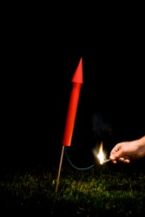
What are some observations you can make about this image?
What inferences could you make based on your observations.
Remember that an observation is something we know by using our senses, whereas an inference is something we predict based on what we think will happen.

Slide 9
We will compare Aboriginal and Torres Strait Islander classification systems to systems used by contemporary science.
TRACK WITH ME
READ WITH ME
We will examine the approach and purpose of Aboriginal and Torres Strait Islander classification systems.
We will use examples of organisms and compare their classification between Aboriginal and Torres Strait Islander and contemporary science classification systems.
DECLARE THE OBJECTIVE
Read the learning objective to your partner.
Notes:
Learning Objectives contain concepts (nouns, big ideas), skills (verbs, measurable behaviours) and sometimes context (restricting or targeting conditions).
●Example: Students will be able to describe the concept of density and apply it to floating and sinking.
●
Success criteria are specific measurable outcomes that if met mean that the student has met the learning objective.
Examples:
•Students will be able to compare densities of substances using mass and volume.
•Students will be able to identify whether a solid or liquid will float or sink in a liquid based on their densities.

Slide 10
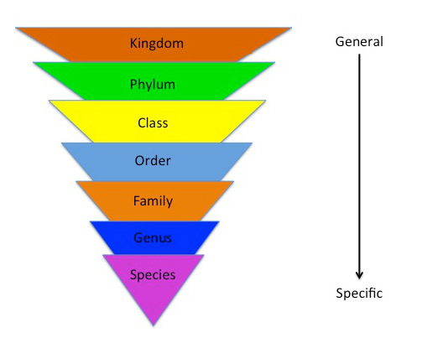
We will compare Aboriginal and Torres Strait Islander classification systems to systems used by contemporary science.
Classification is a system of sorting organisms₁ such as plants and animals into different groups based on observable₂ features.
Scientists classify organisms for the following reasons:
Organisation
I_______________
C______________
MAKE THE CONNECTION
Students, you already know that scientists organise and classify organisms.

Slide 11
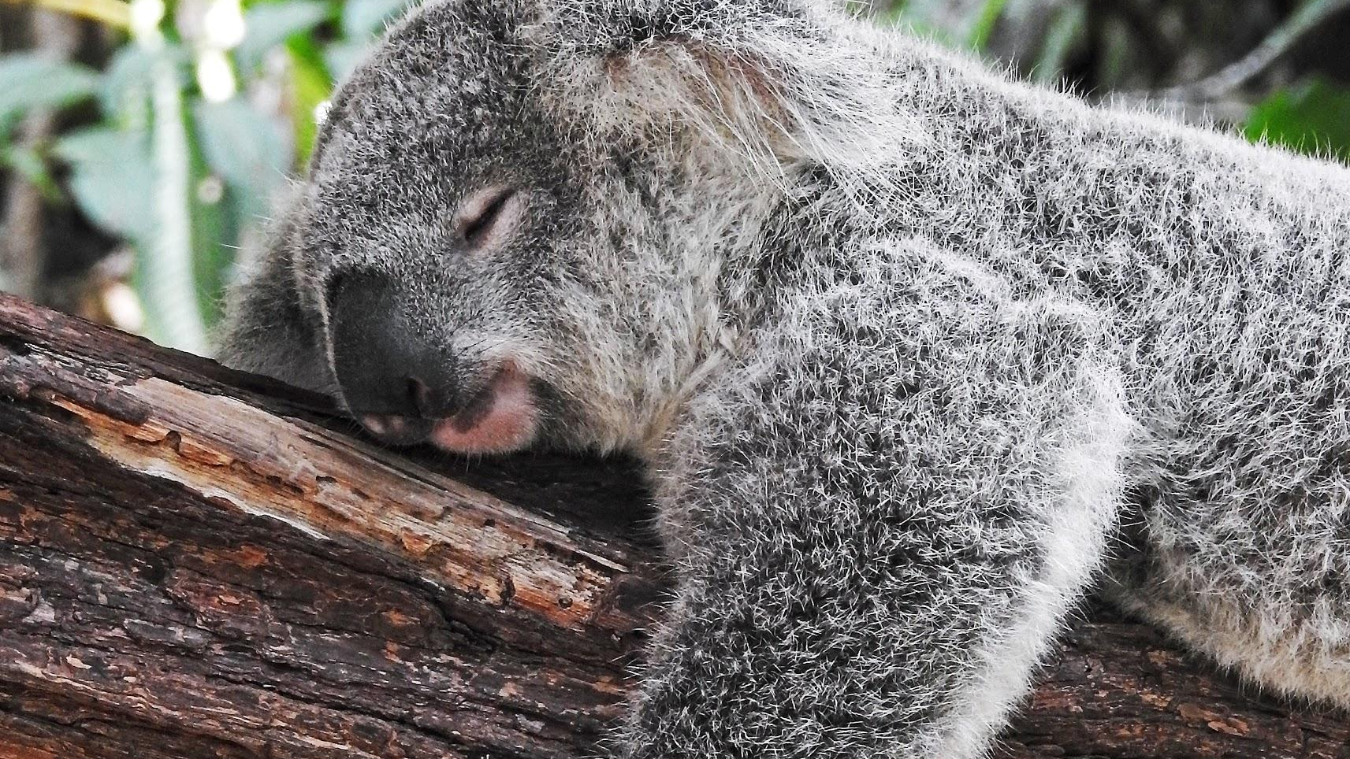
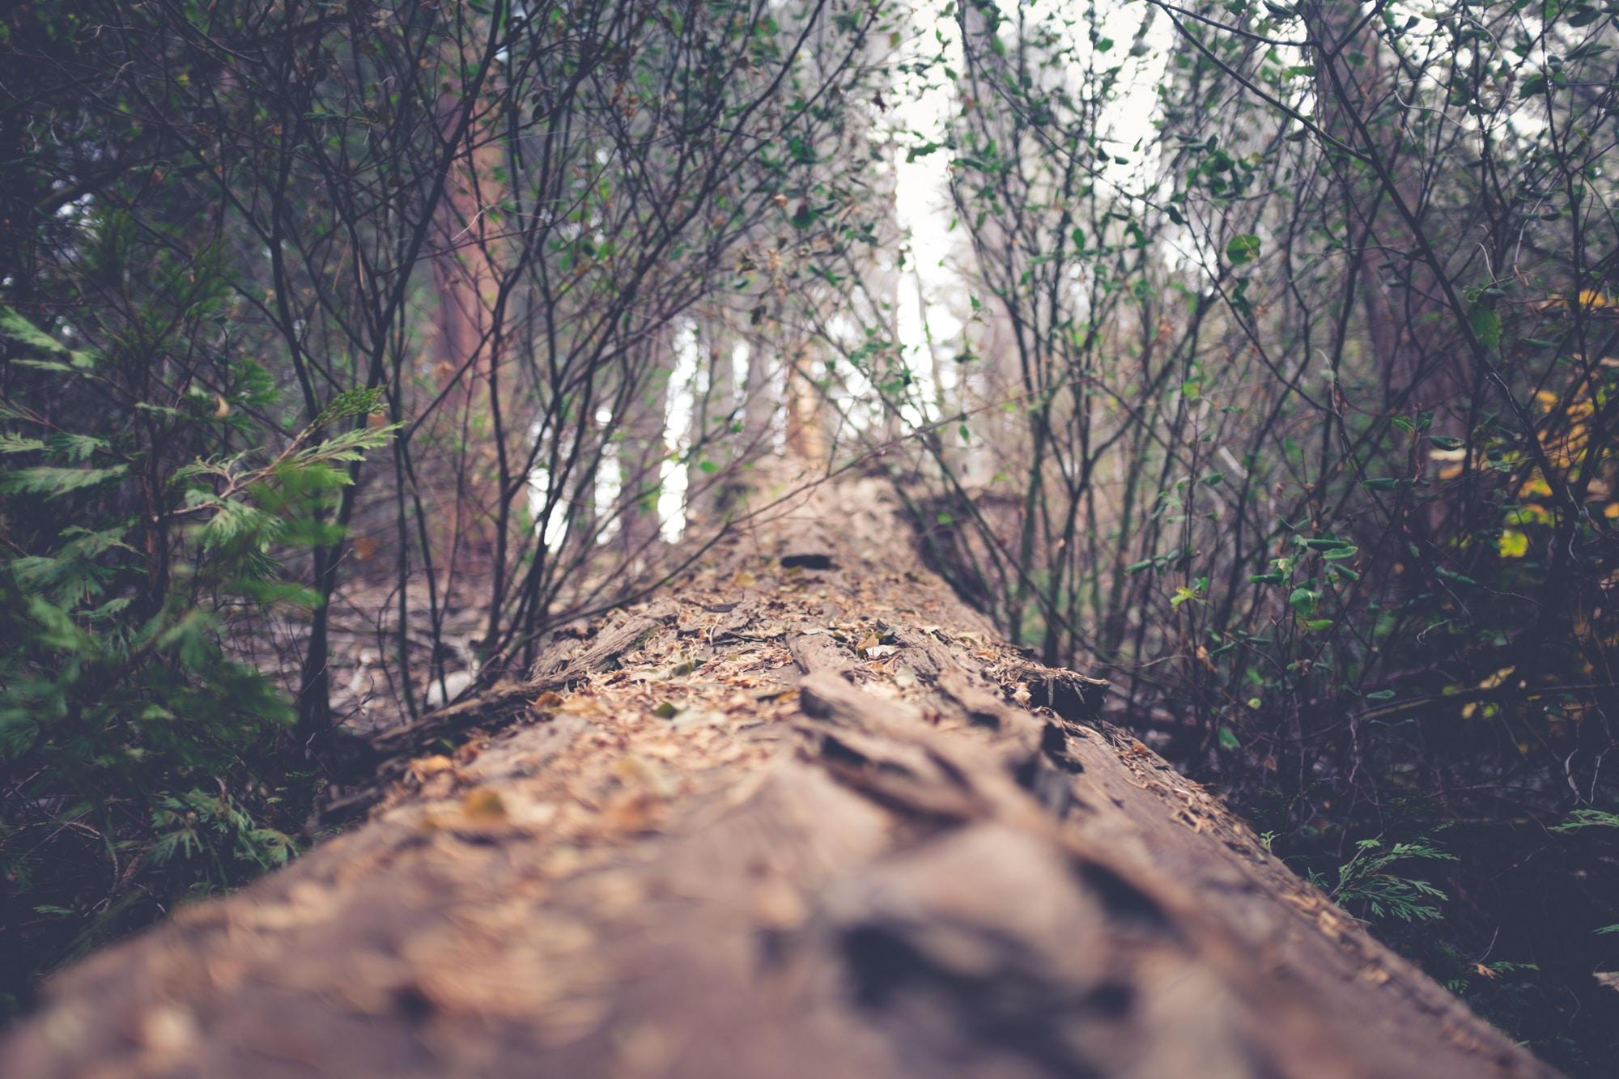
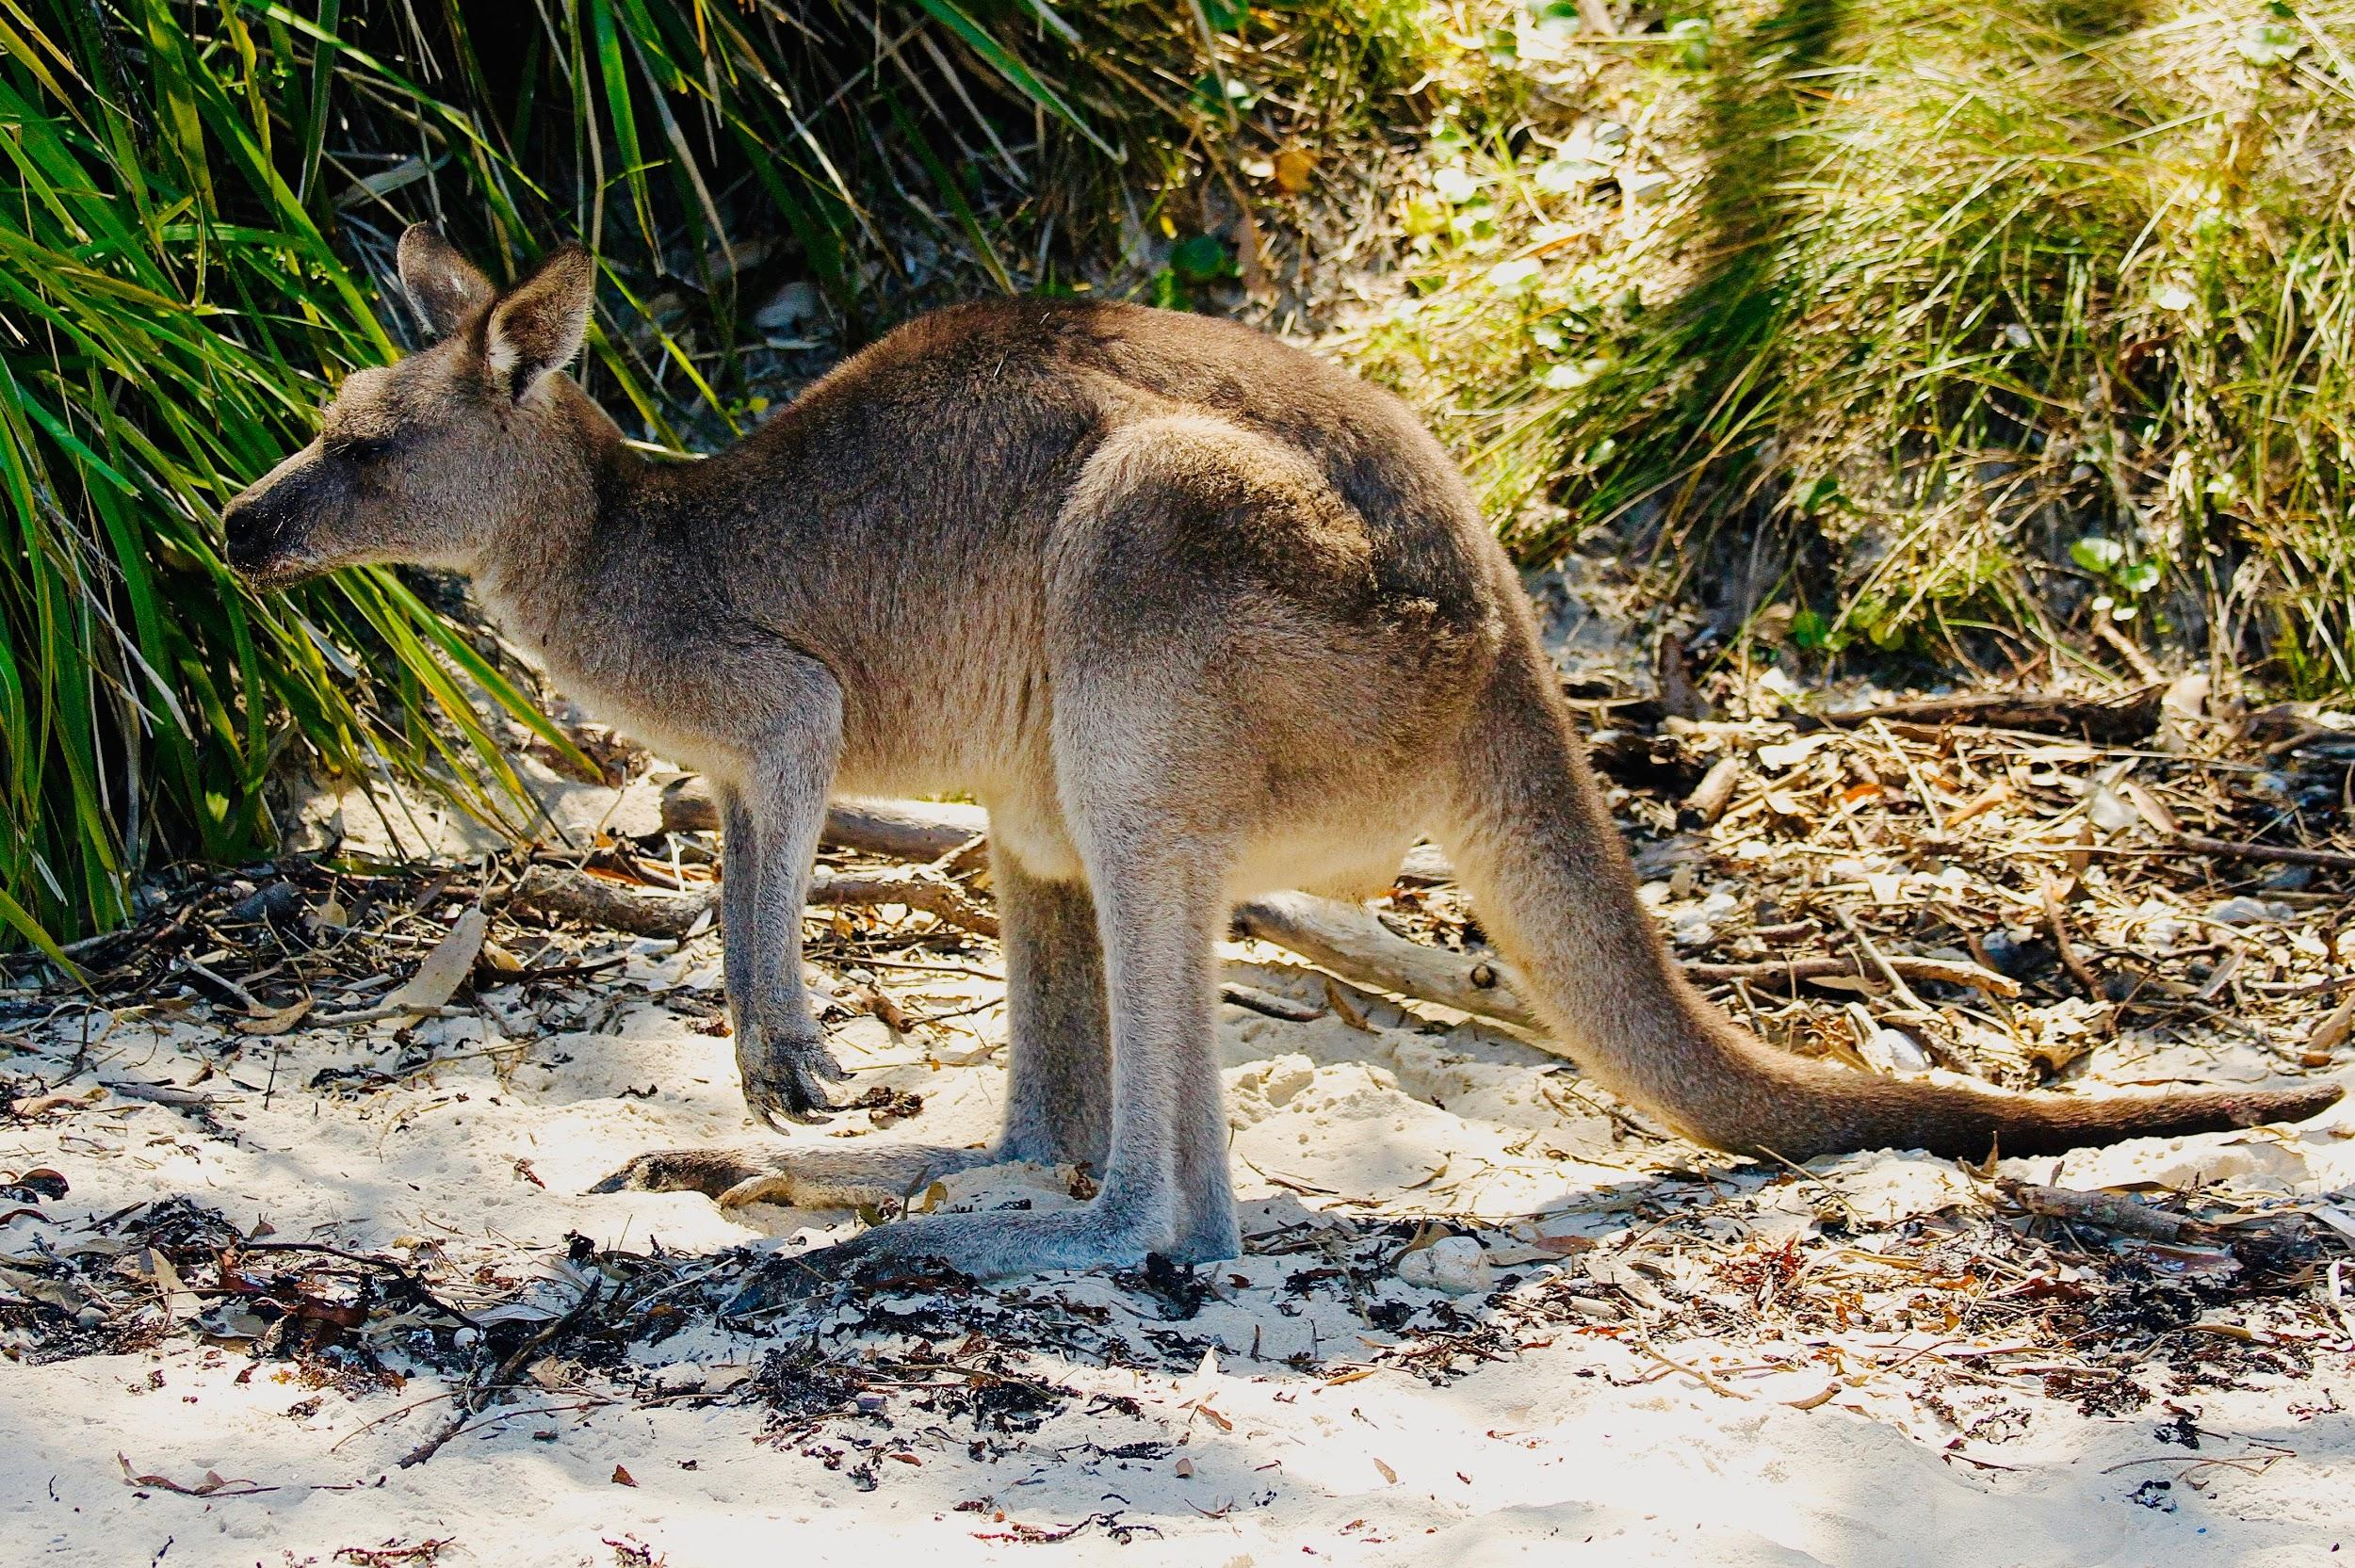
We will compare Aboriginal and Torres Strait Islander classification systems to systems used by contemporary science.
CHECK FOR UNDERSTANDING
Aboriginal & Torres Strait Islander nations classify organisms based on? Age Taste Use Colour Totemic Association Sex Social Status Stage In Life Cycle Size
There are many ways to classify different organisms.
Aboriginal and Torres Strait Islander nations use classification systems that categorise organisms based on the organisms’ use, age, stage in life cycle, sex, social status and symbolic₁ meaning.
Organisms are often classified for their use in society. Binary₁ classifications like edible or inedible and totemic or non-totemic are used to arrange organisms.
VOCABULARY
1 - Connecting with a concept. 2 - Two options.

Slide 12
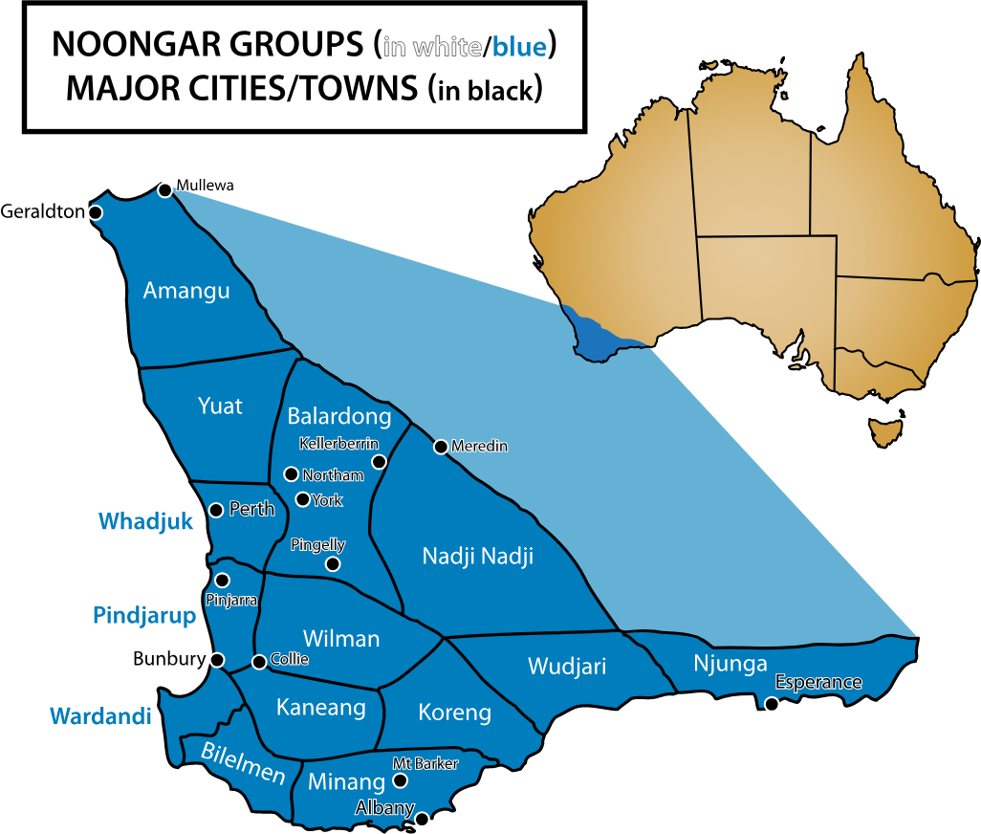
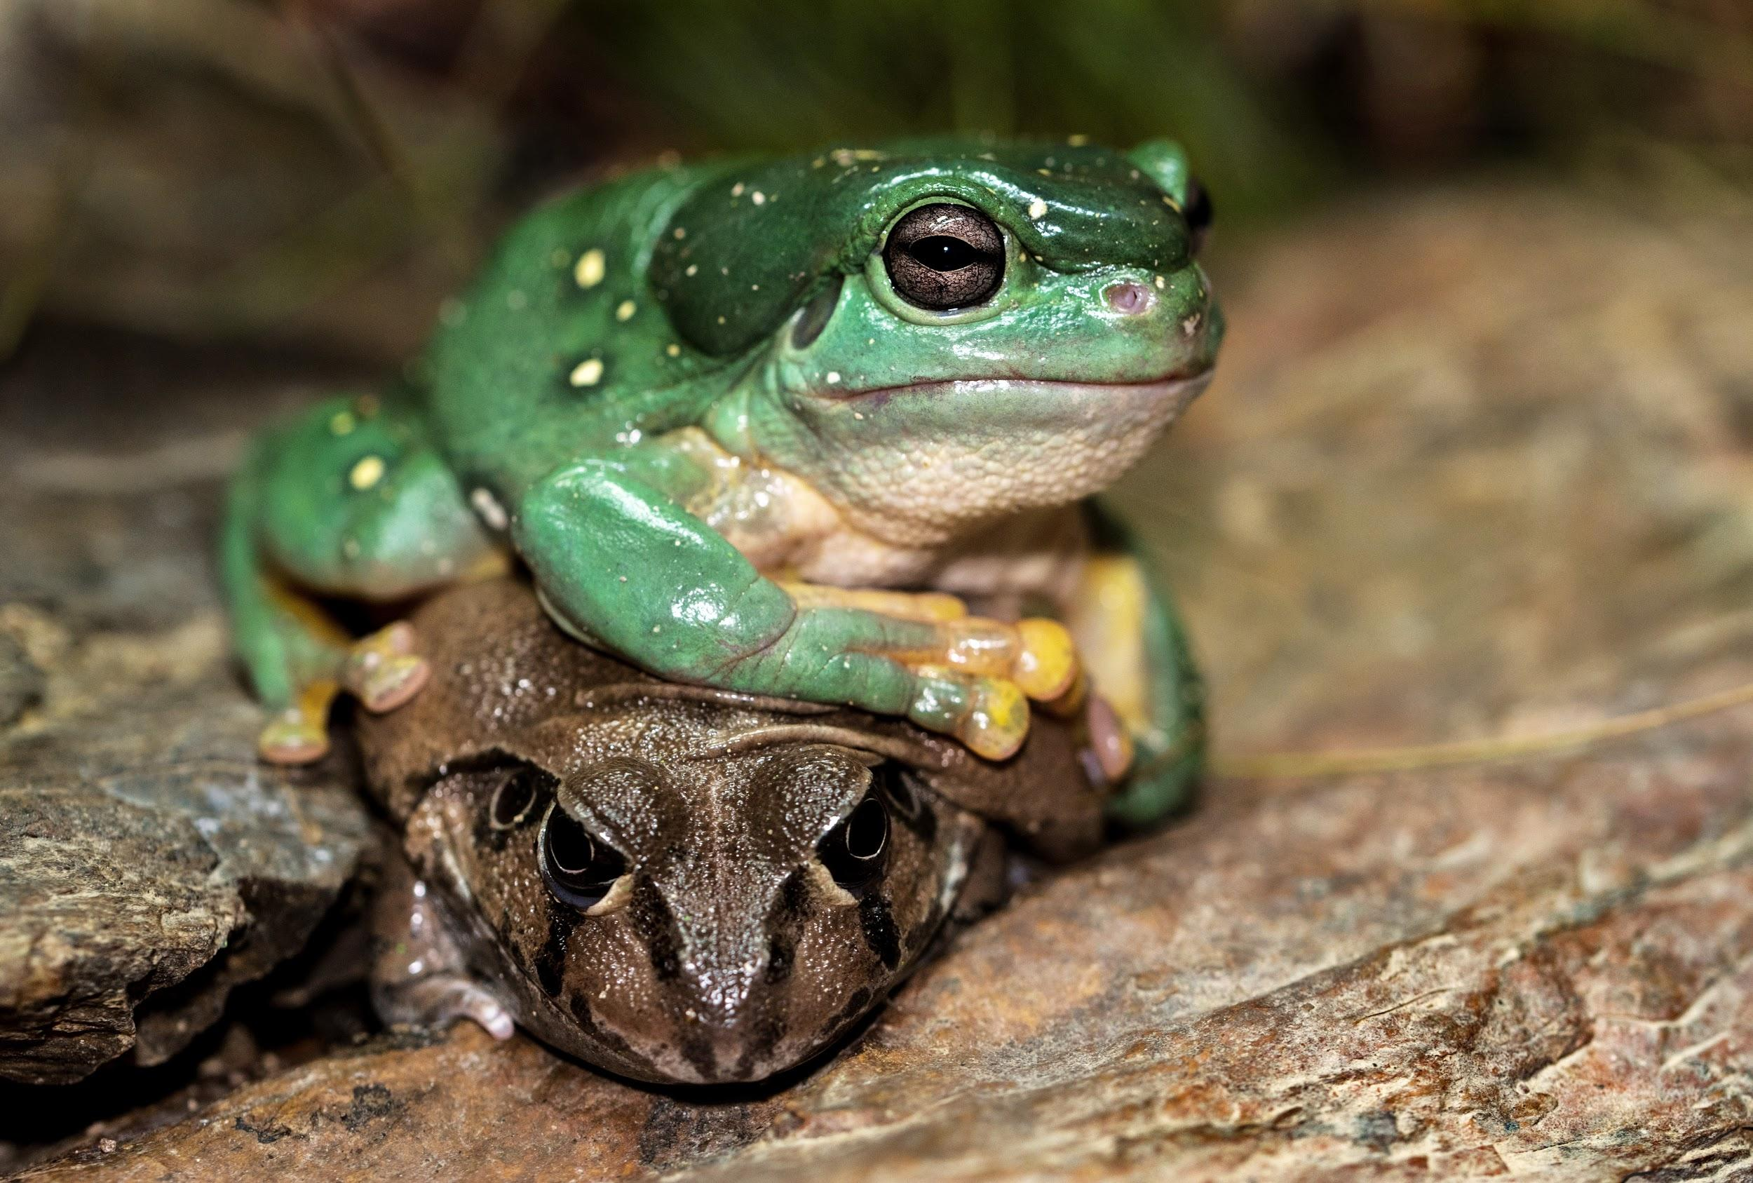
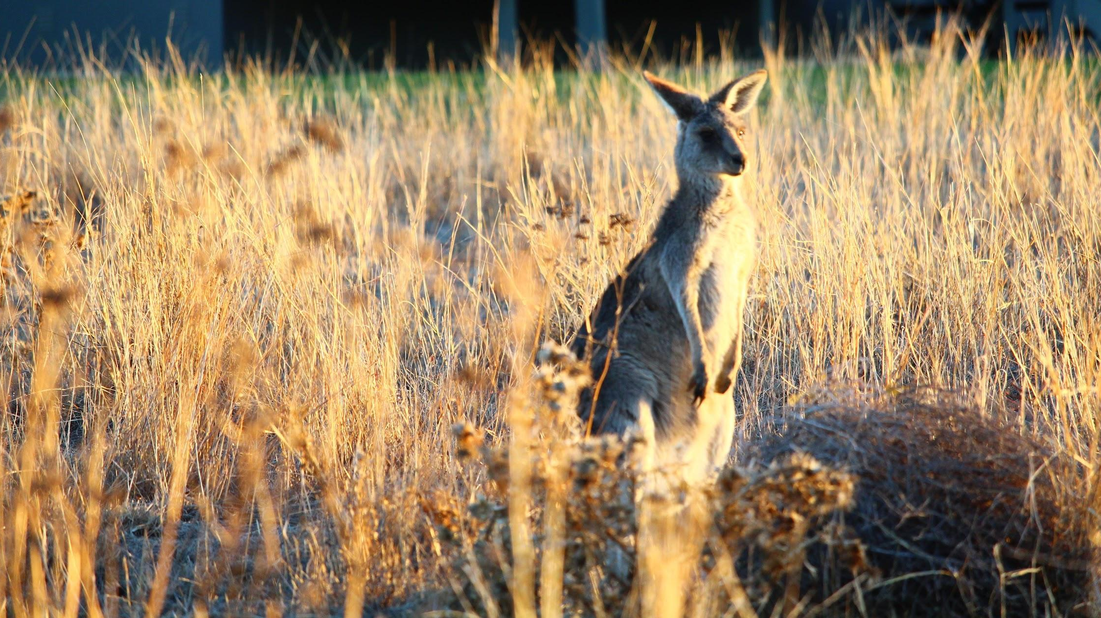
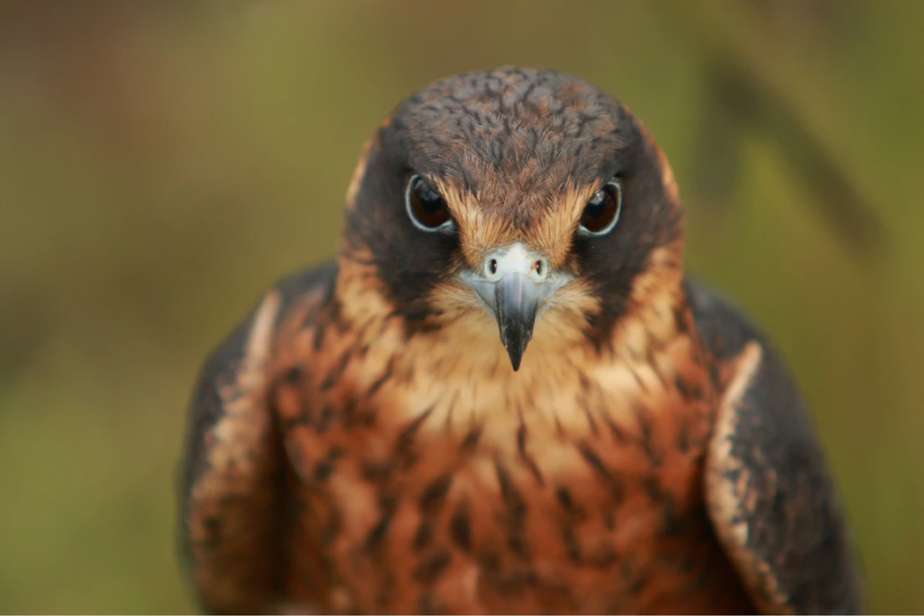
CHECK FOR UNDERSTANDING
Looking at the map, which area is Perth located in?
We will compare Aboriginal and Torres Strait Islander classification systems to systems used by contemporary science.
In Noongar country there are 14 different areas with 14 different language groups.
One of those groups is Whadjuk.

Slide 13
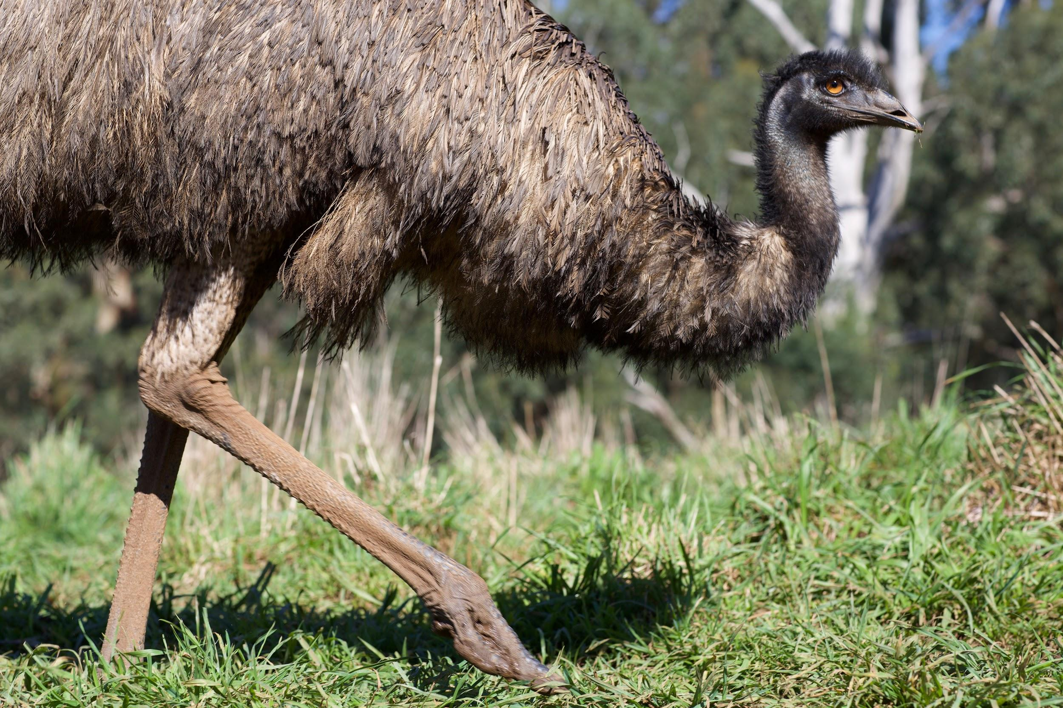
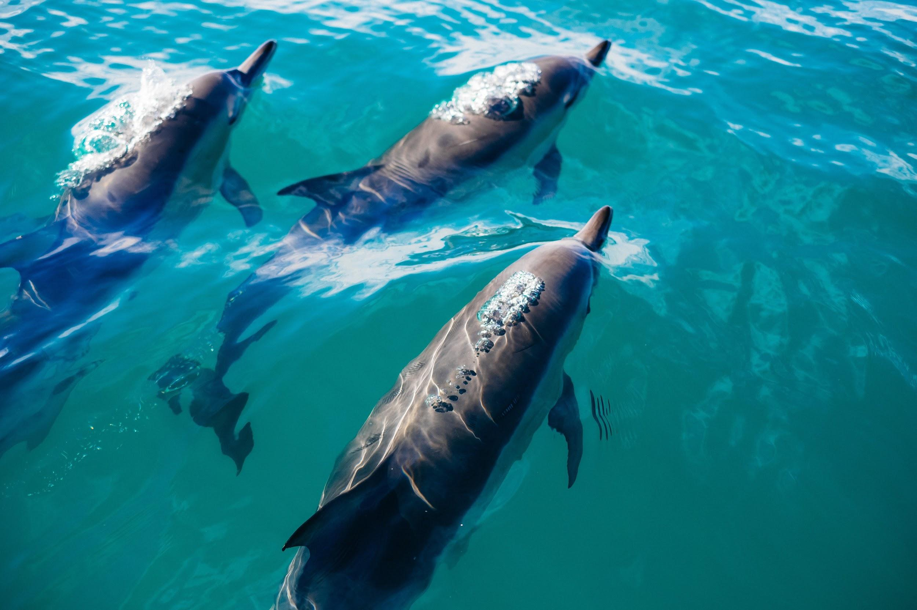
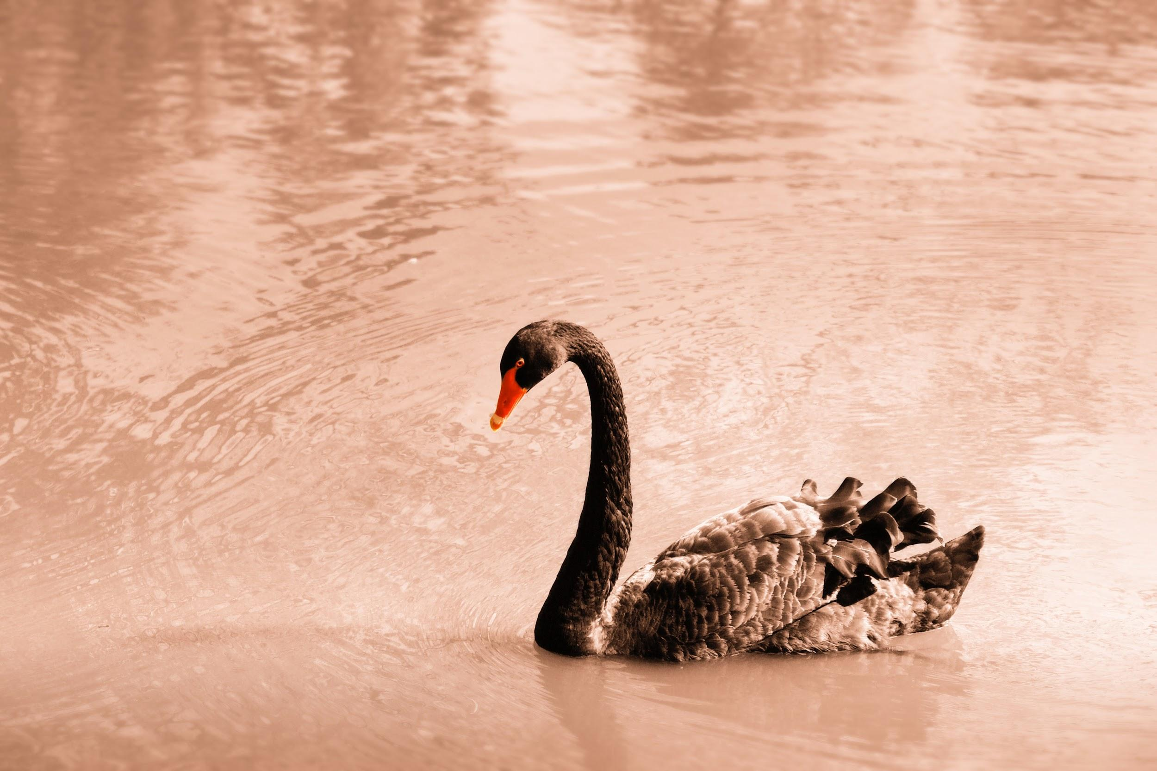
We will compare Aboriginal and Torres Strait Islander classification systems to systems used by contemporary science.
CHECK FOR UNDERSTANDING
Create a T-Chart to categorise the organisms below as being totemic₁ or non-totemic to Noongar people. Lion - Eagle - Kangaroo Bulldog - Turtle - Polar Bear Black Swan - White Swan
Whadjuk Noongar people, and other Indigenous groups, may identify with an animal totem₁.
They have a respect and responsibility for their totem which they need to protect and preserve.
Common Noongar totems include yarkan (turtles), kwooyar (frogs), yoorn (goanna), weitj (emu), kip (dolphin), maali (black swan), yonga (kangaroo) and waalitj (eagle).
VOCABULARY
1 - an object or organism with cultural meaning 2 - a totem of

Slide 14
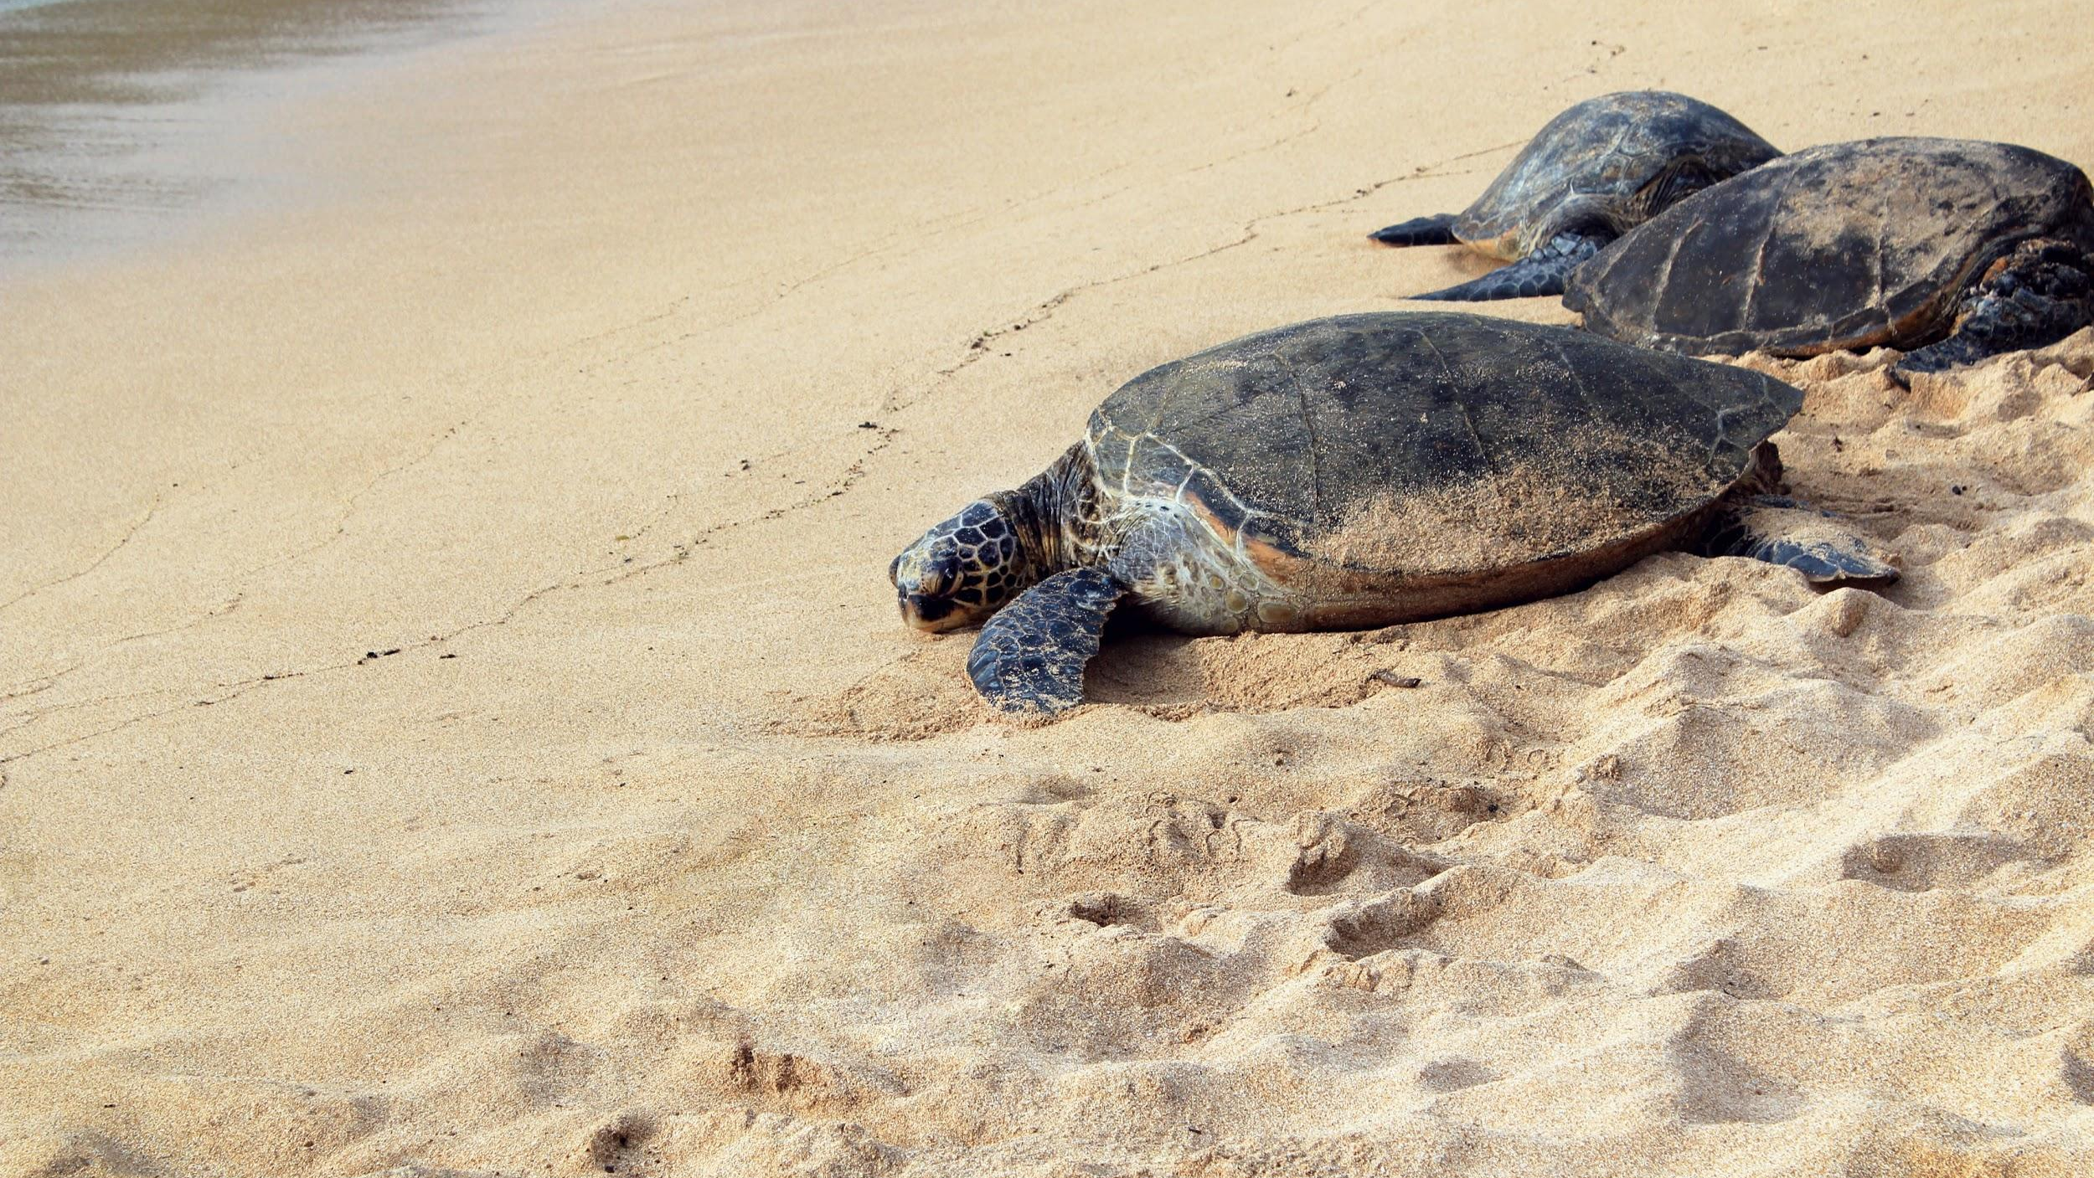
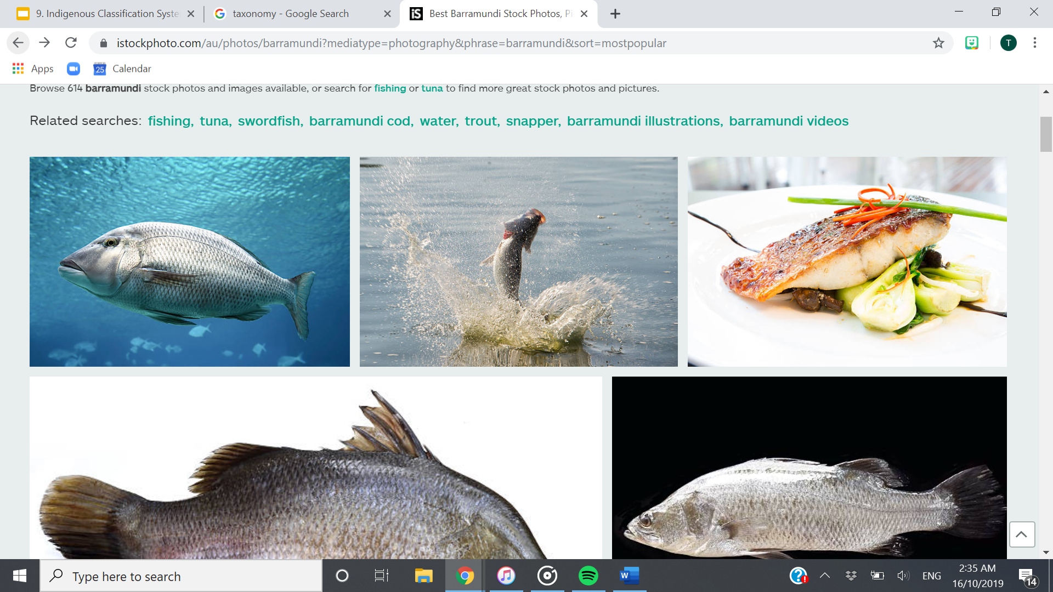
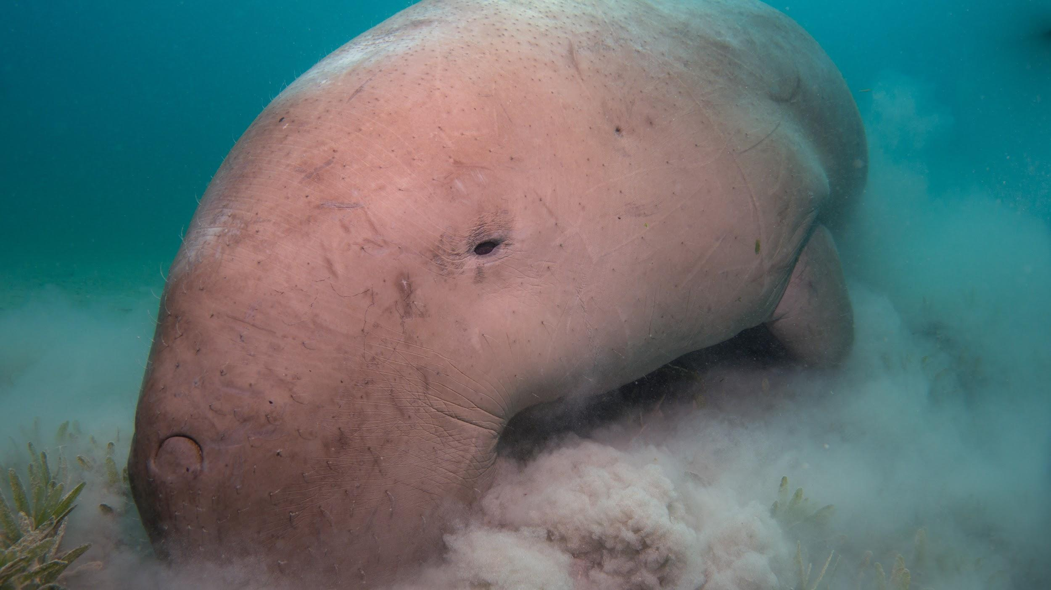
We will compare Aboriginal and Torres Strait Islander classification systems to systems used by contemporary science.
CHECK FOR UNDERSTANDING
Why would Aboriginal & Torres Strait Islander nations classify these organisms into the same group? They belong to the same species. Indigenous culture classified organisms based on their use, and so it wasn’t necessary. They have the same features as one another.
Aboriginal and Torres Strait Islander nations classify organisms based on features and habitat.
For example, turtles, barramundi and dugong are classified into the same group because they are all aquatic creatures with fins or flippers.
The Linnaean classification system classifies them differently. All classification systems evolve over time.

Slide 15

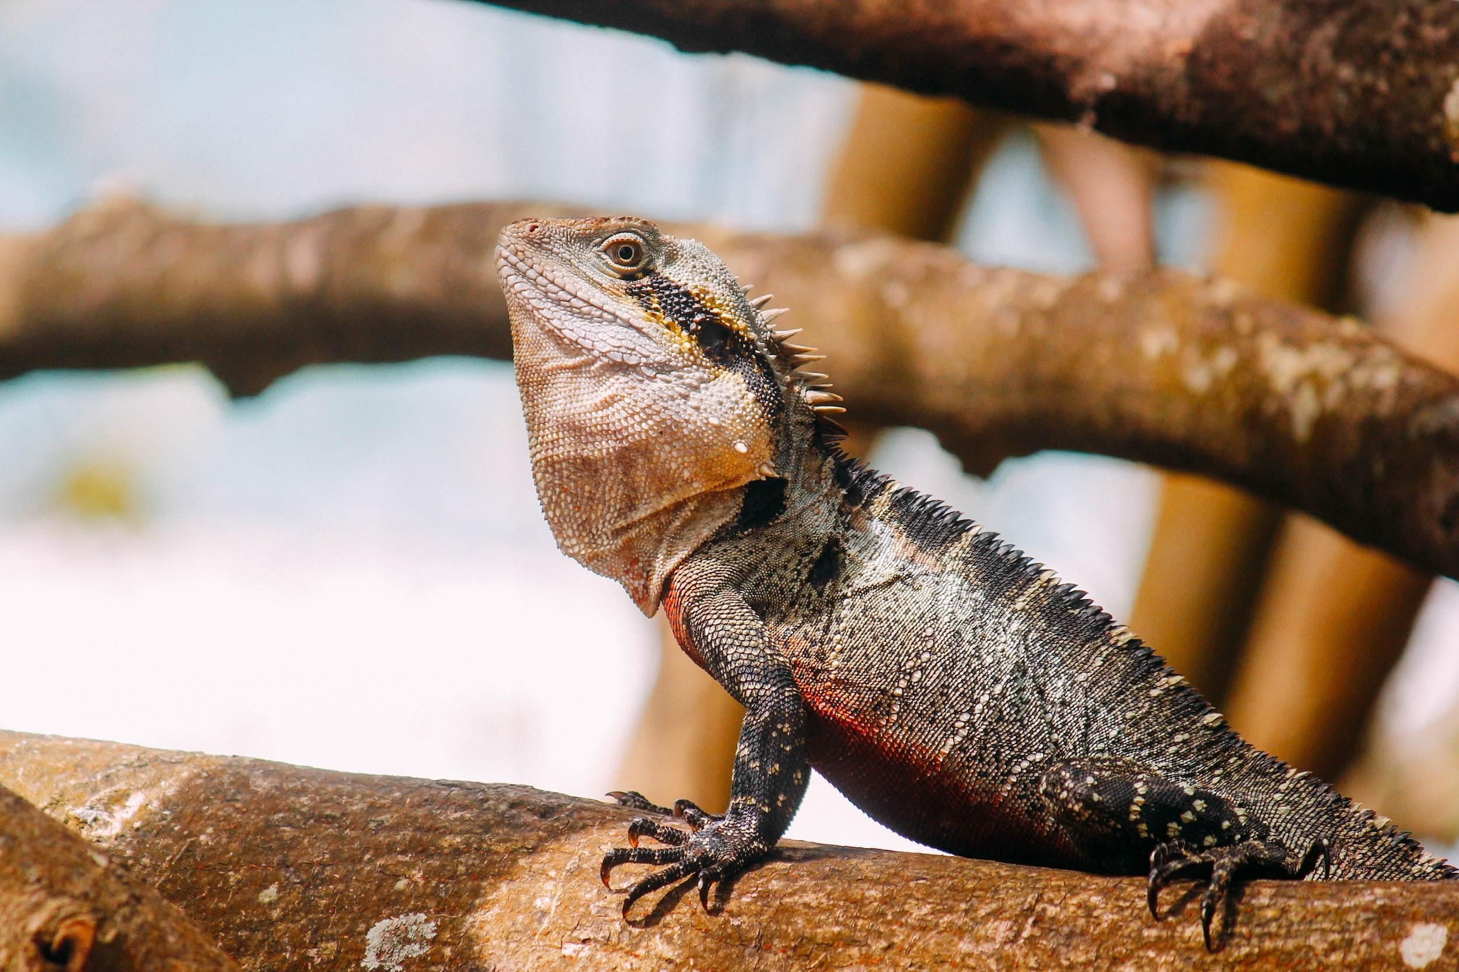
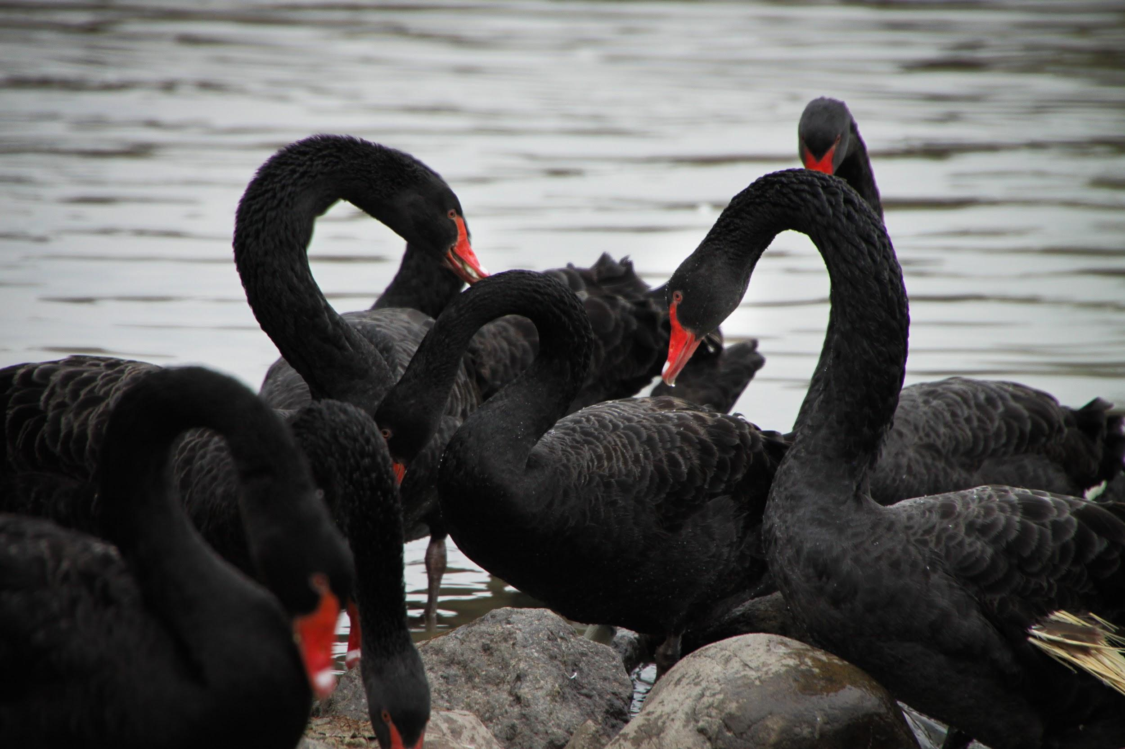
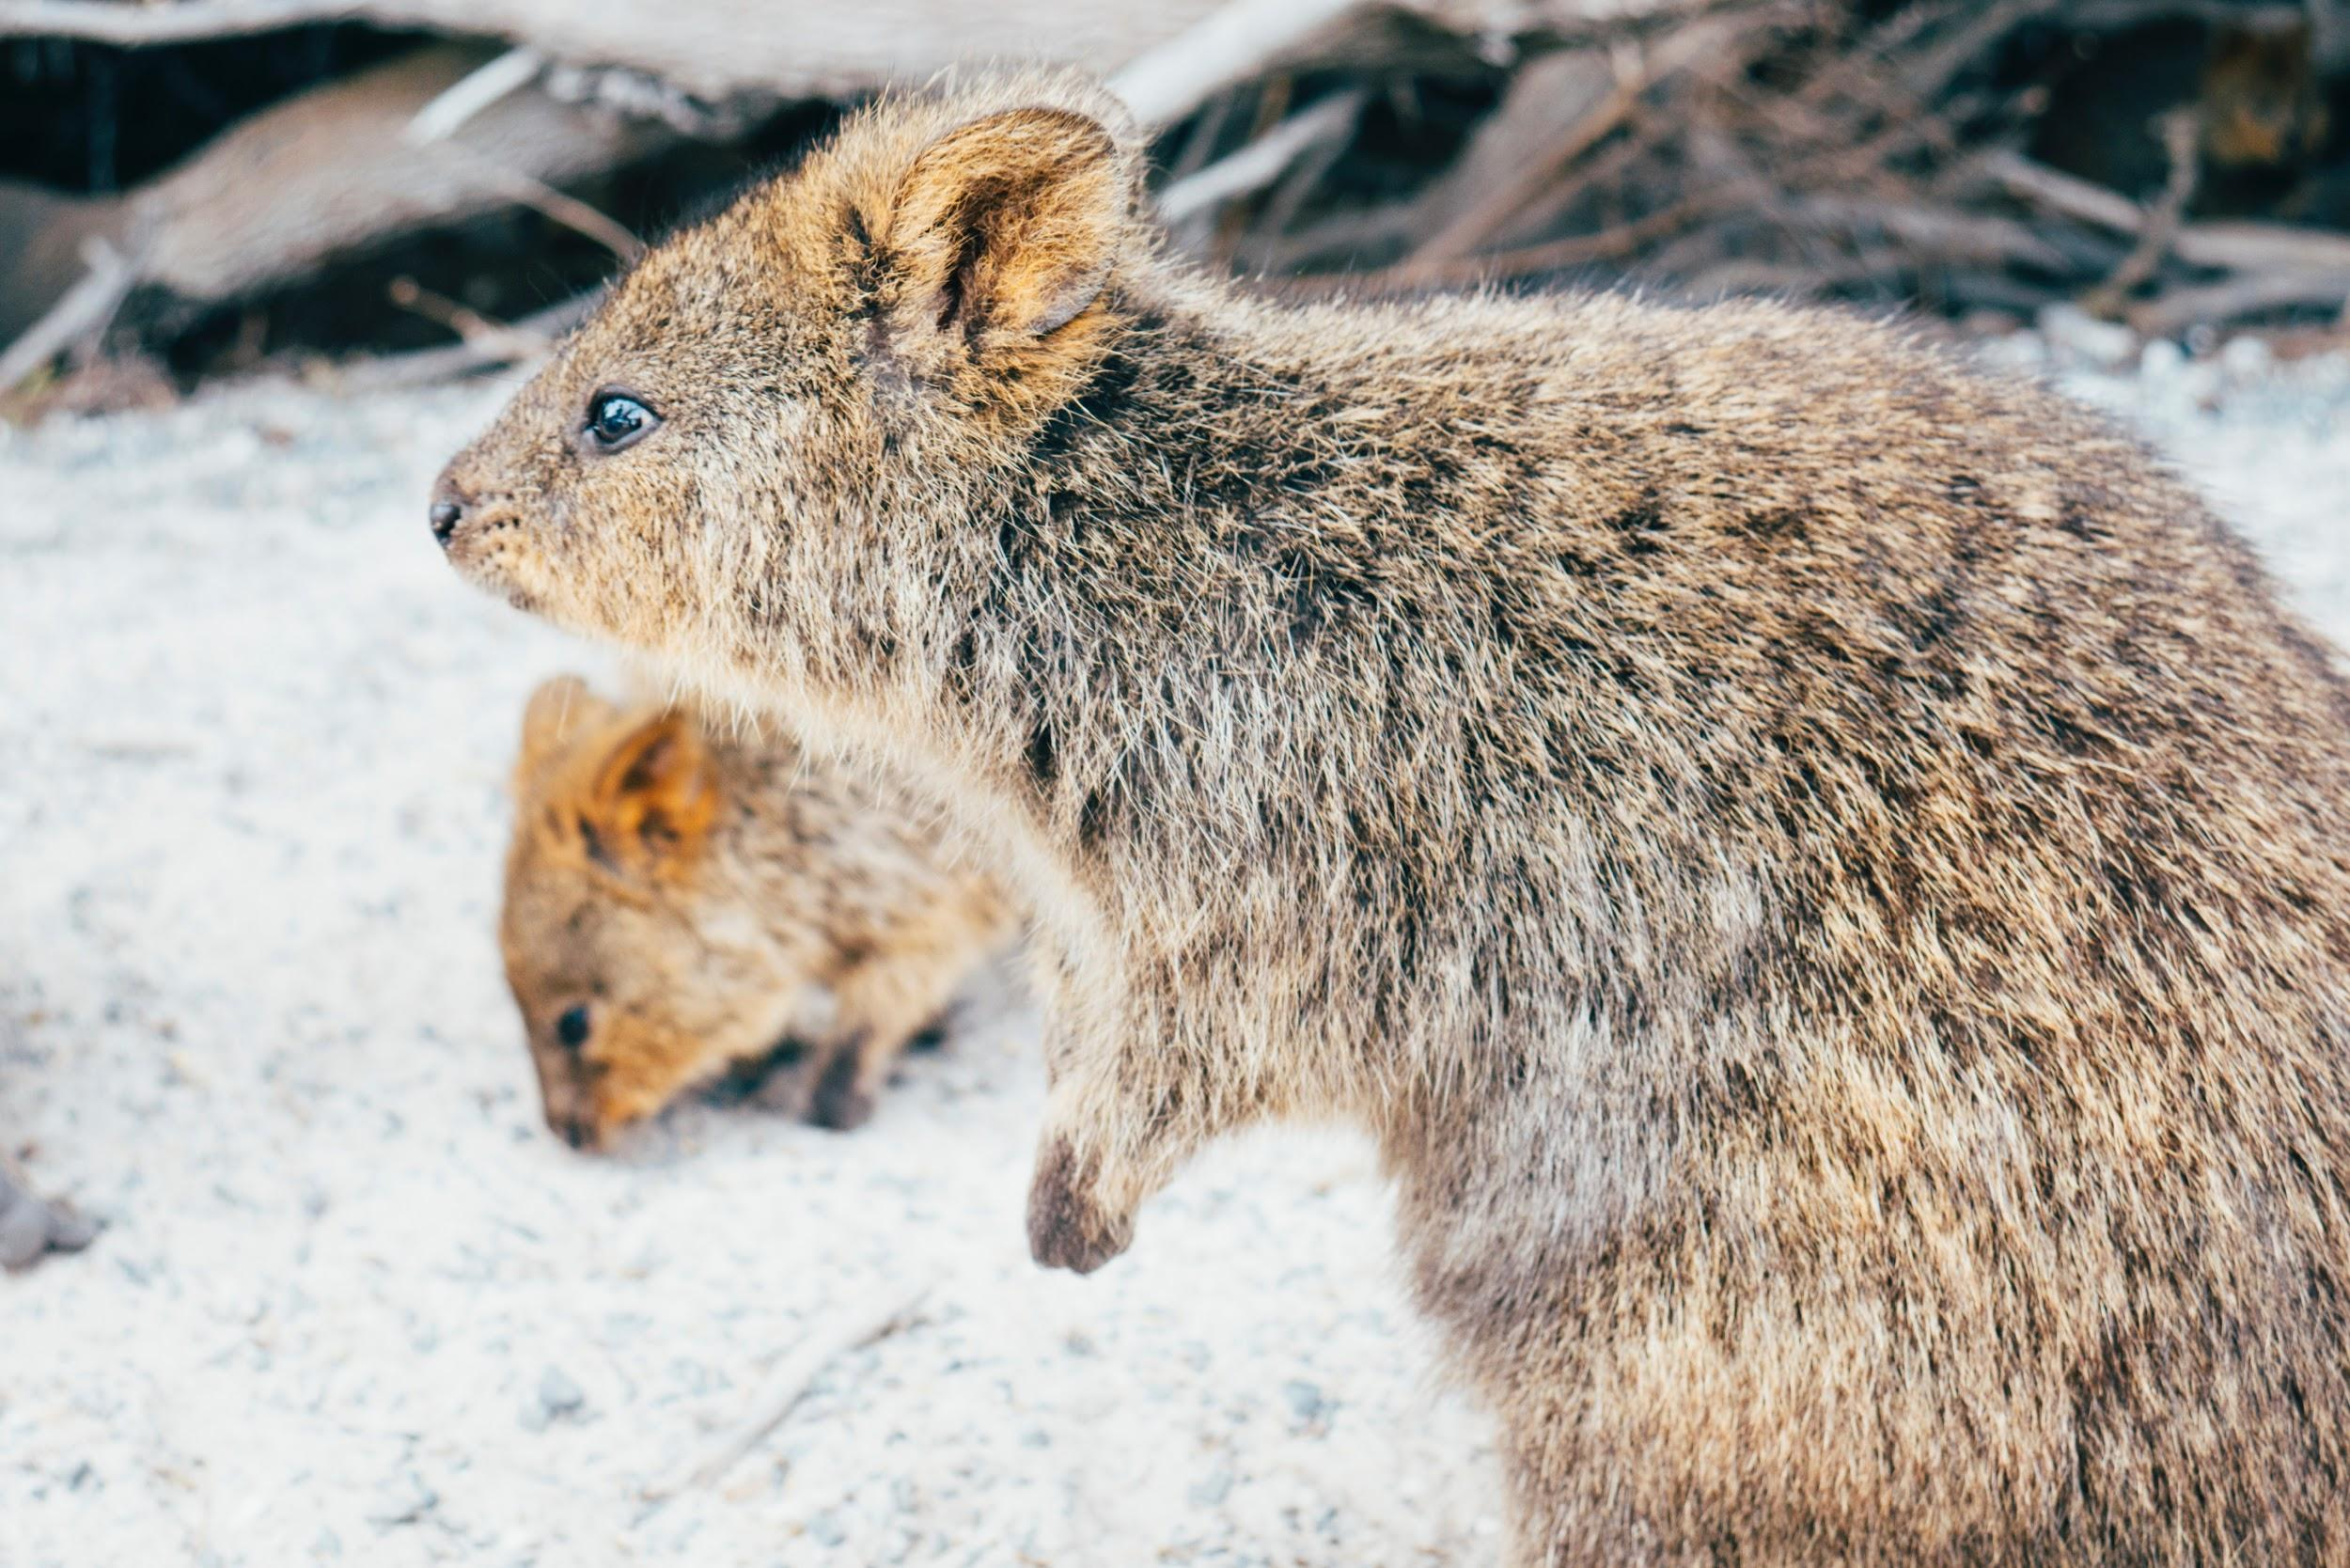
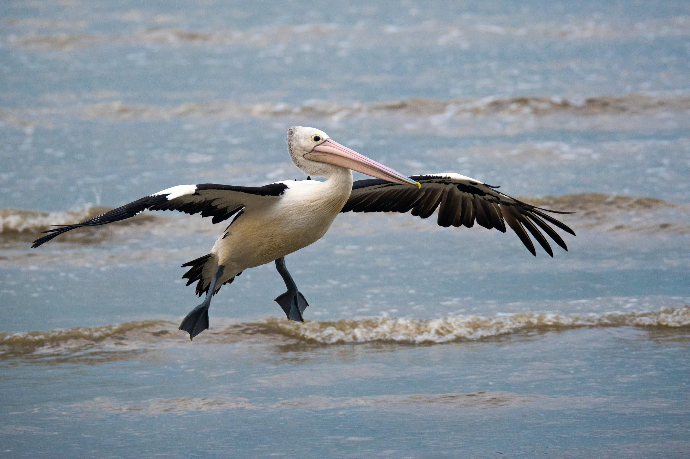
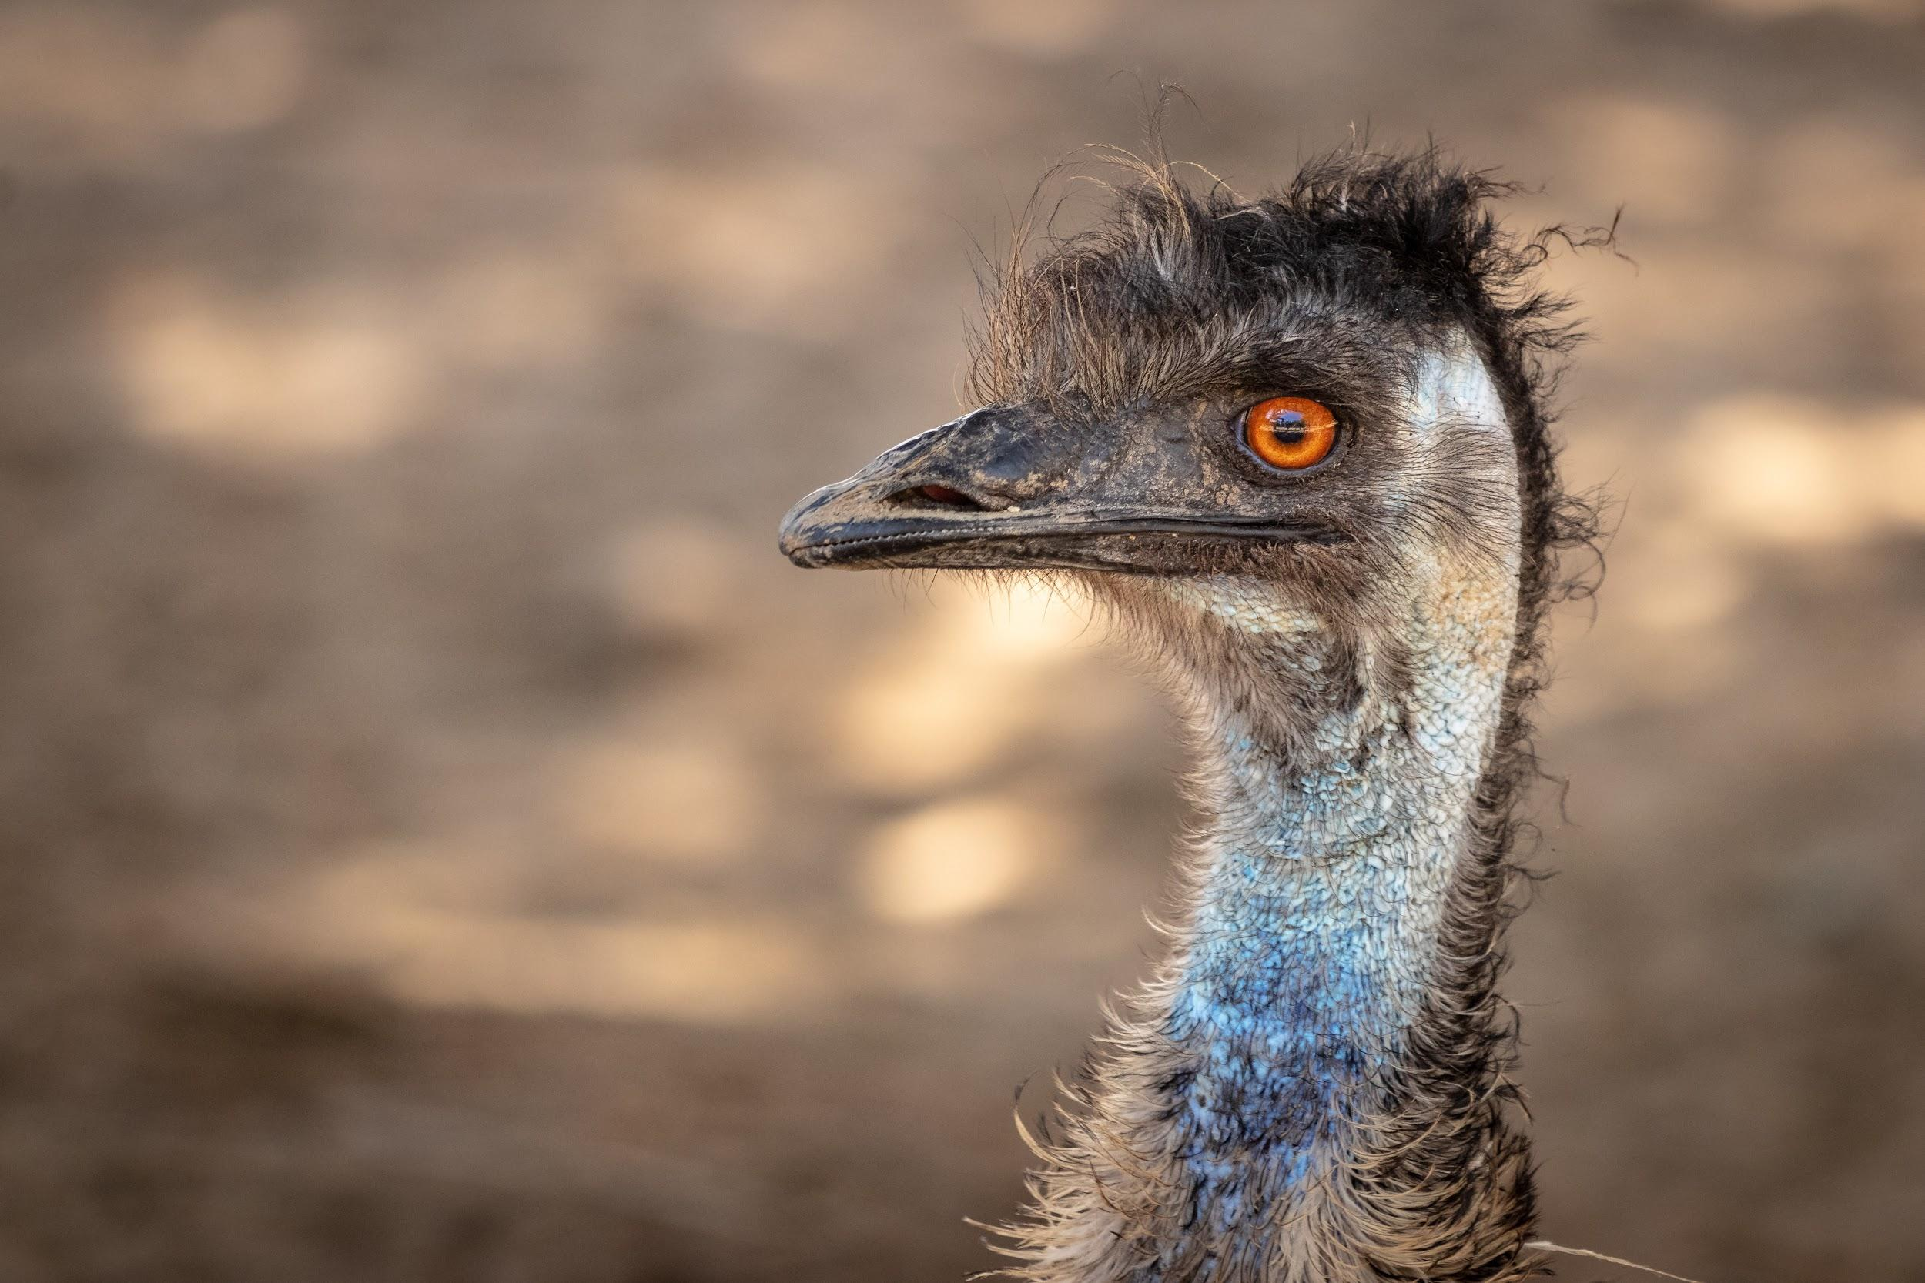
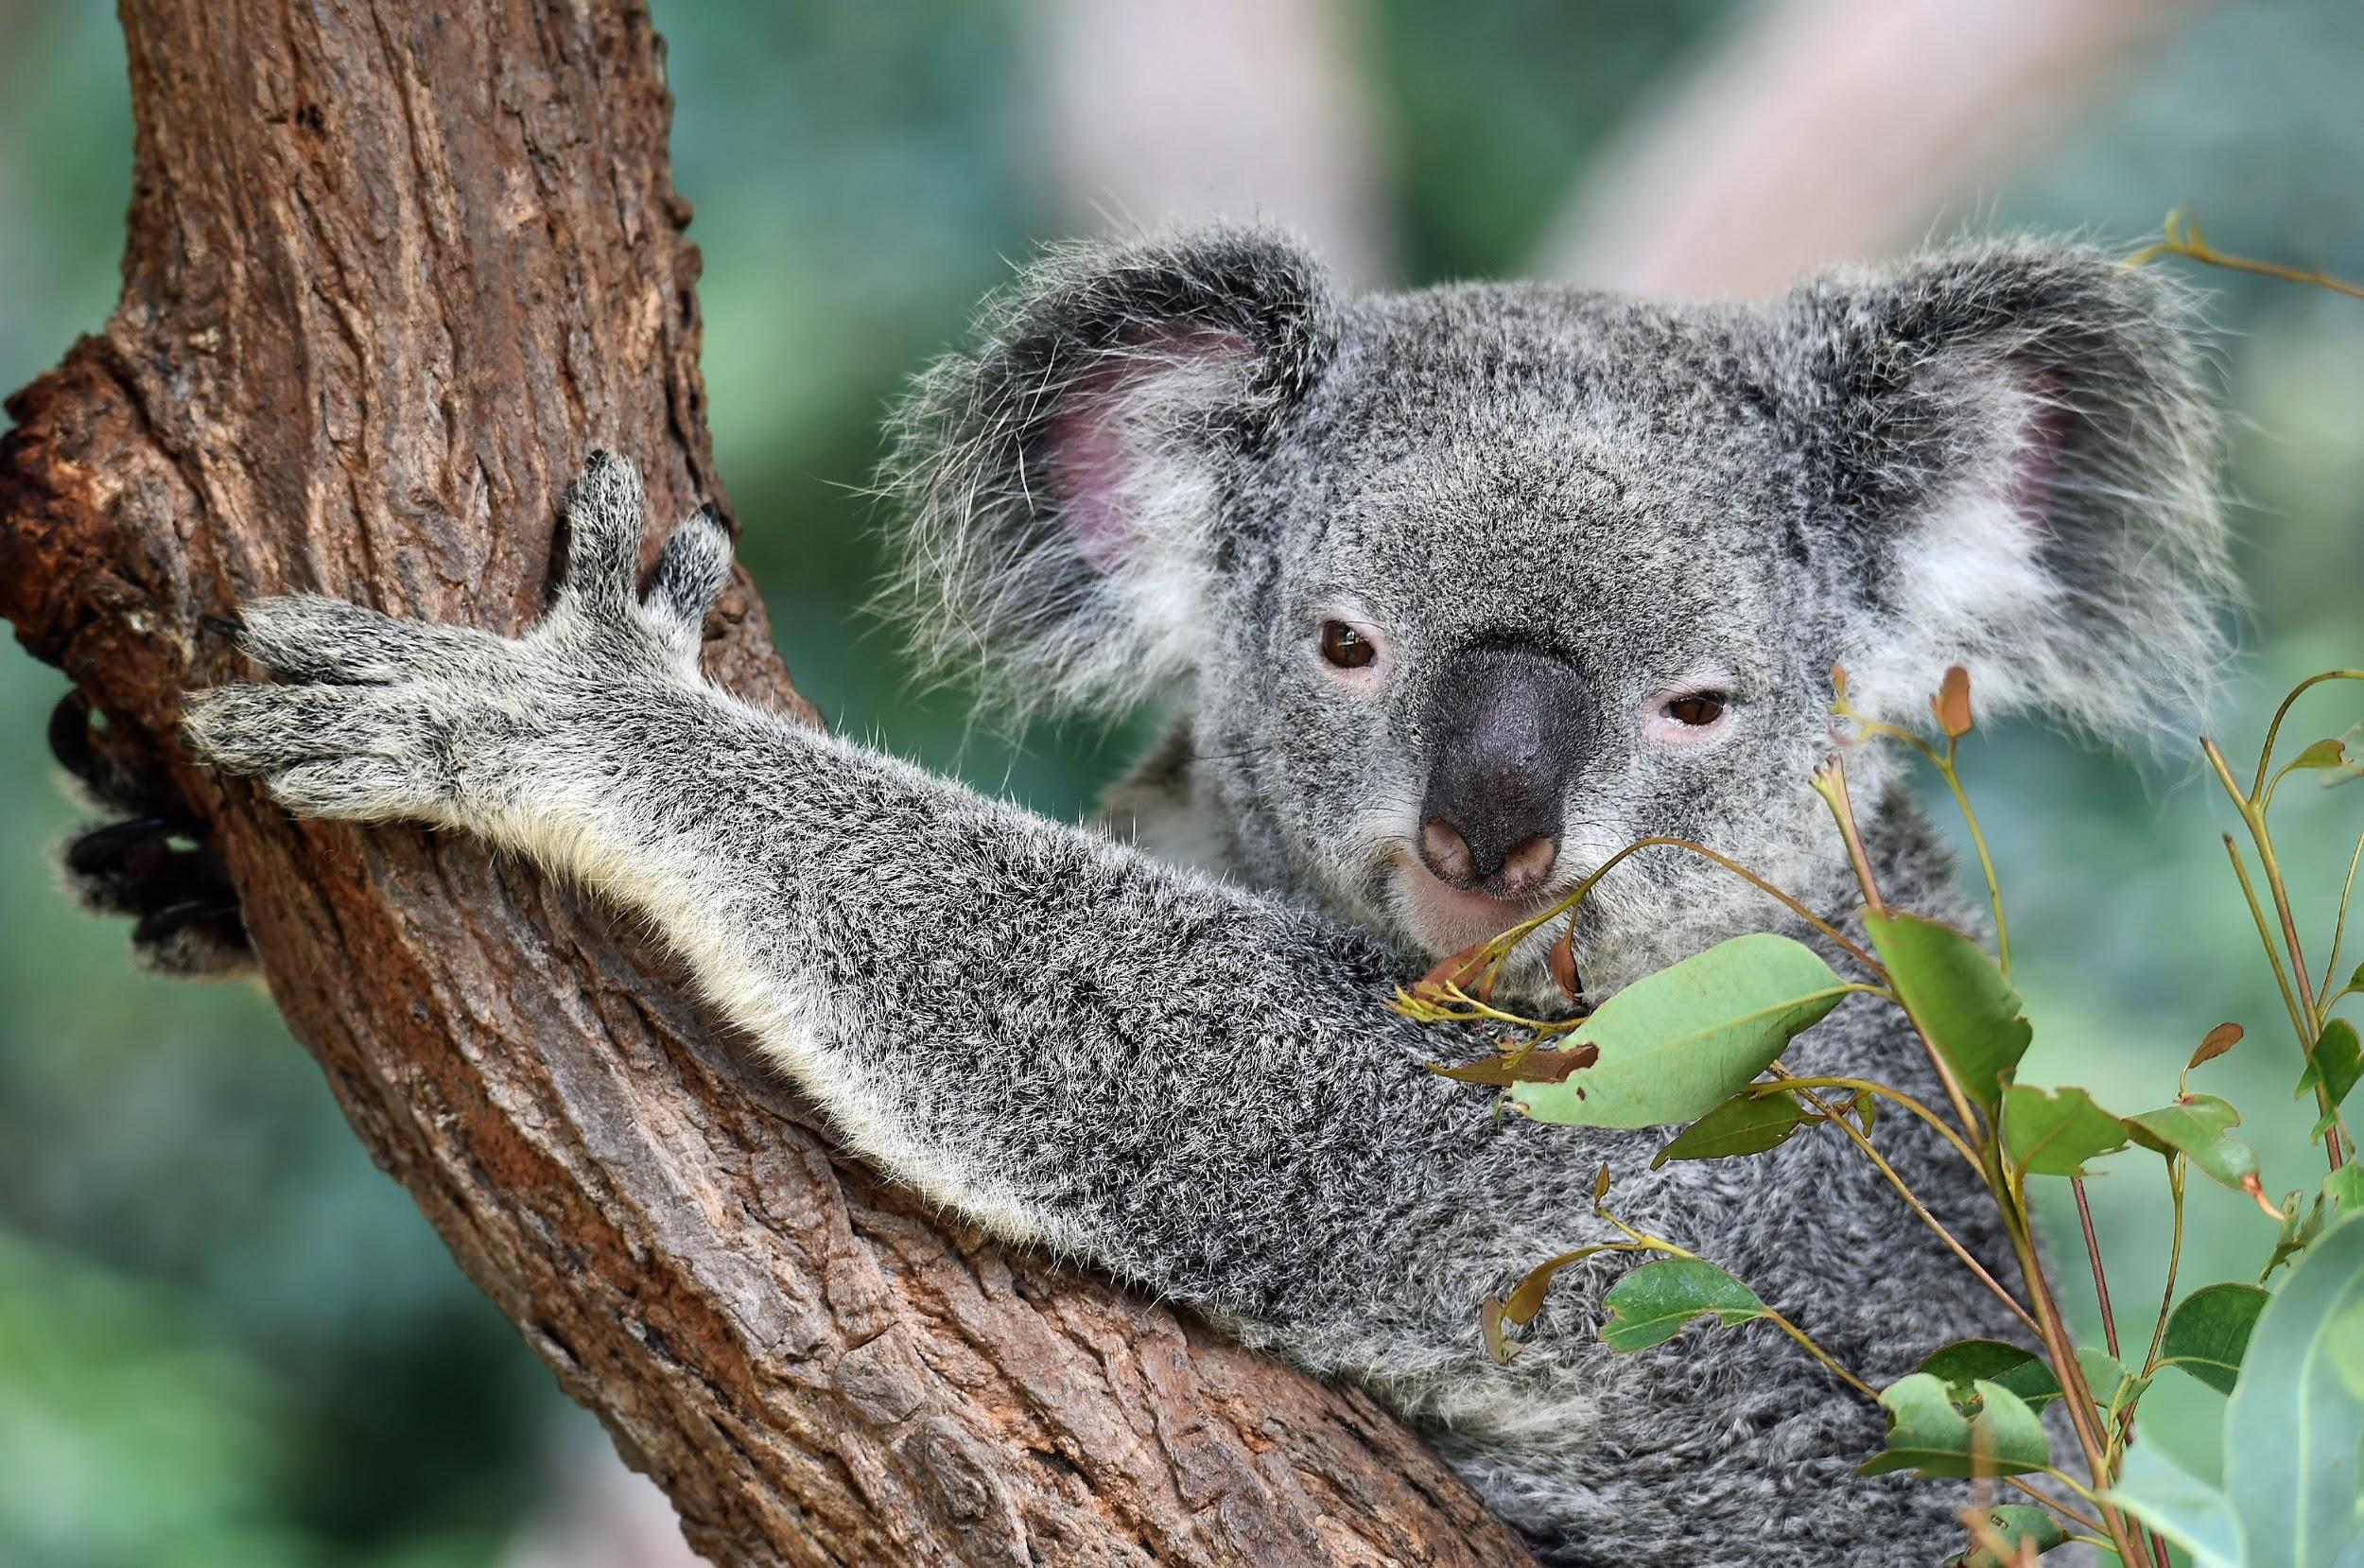
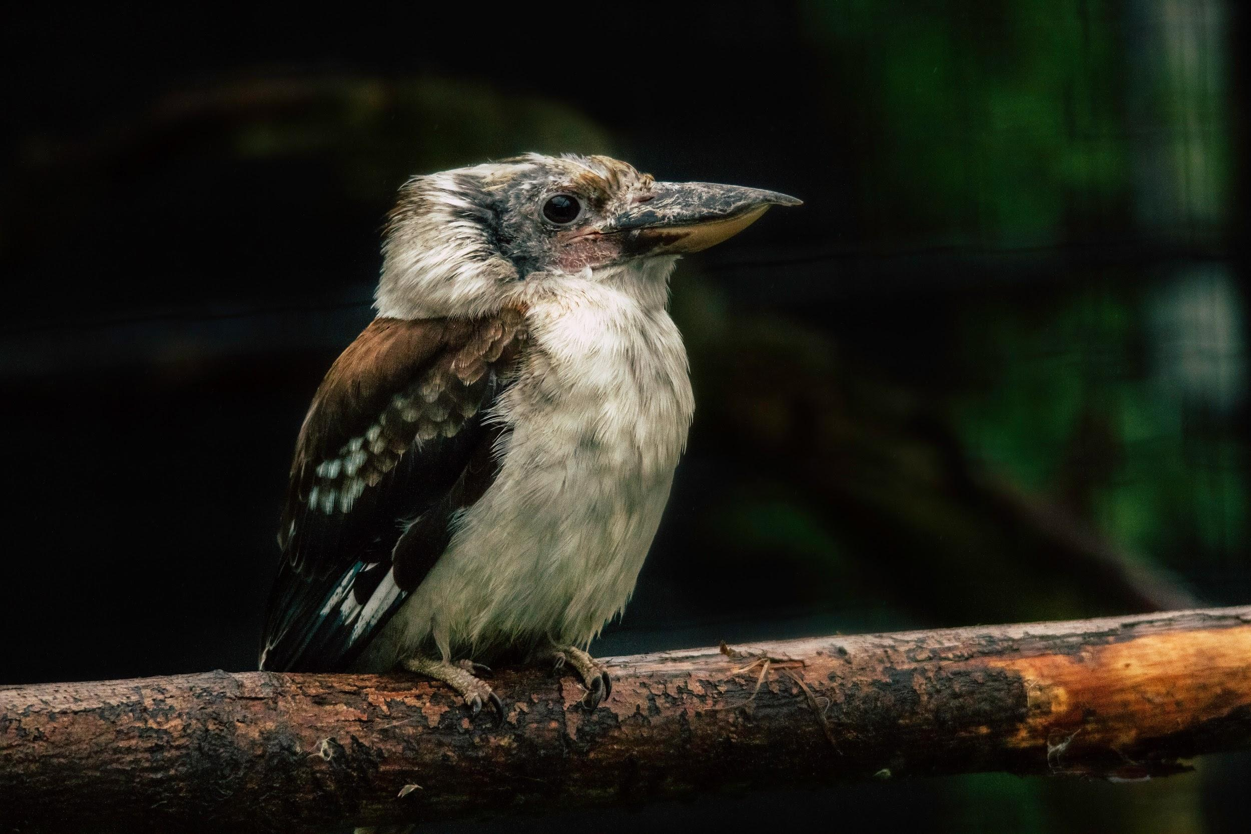
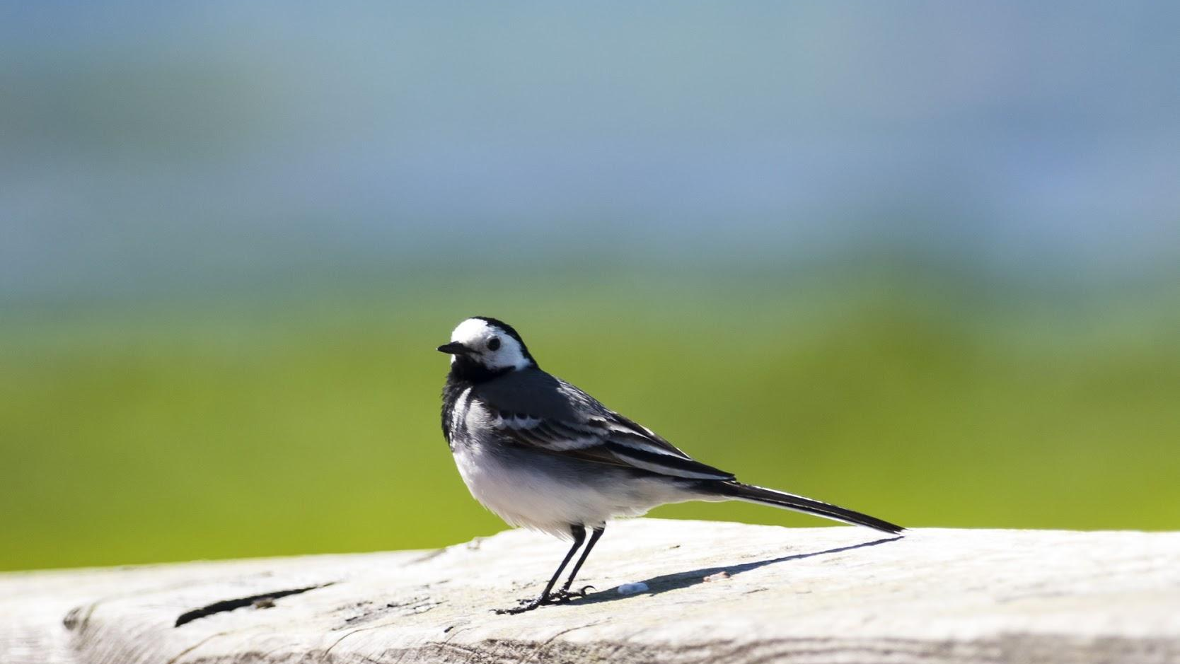
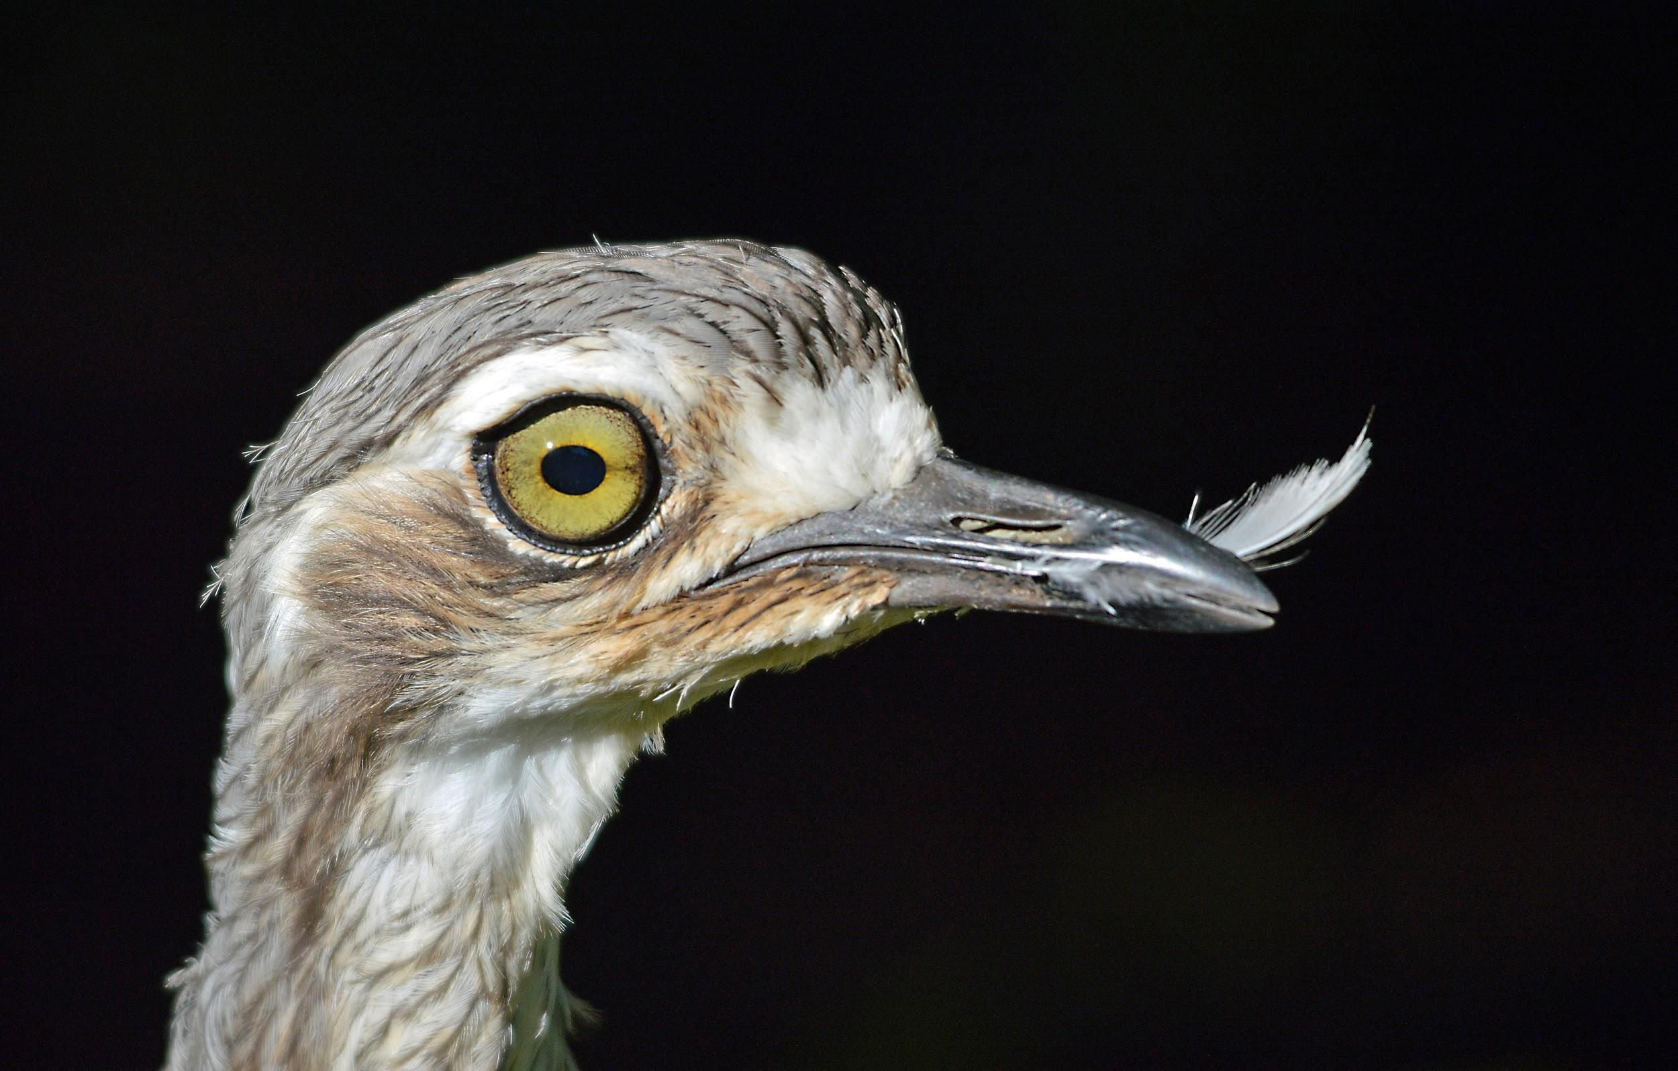
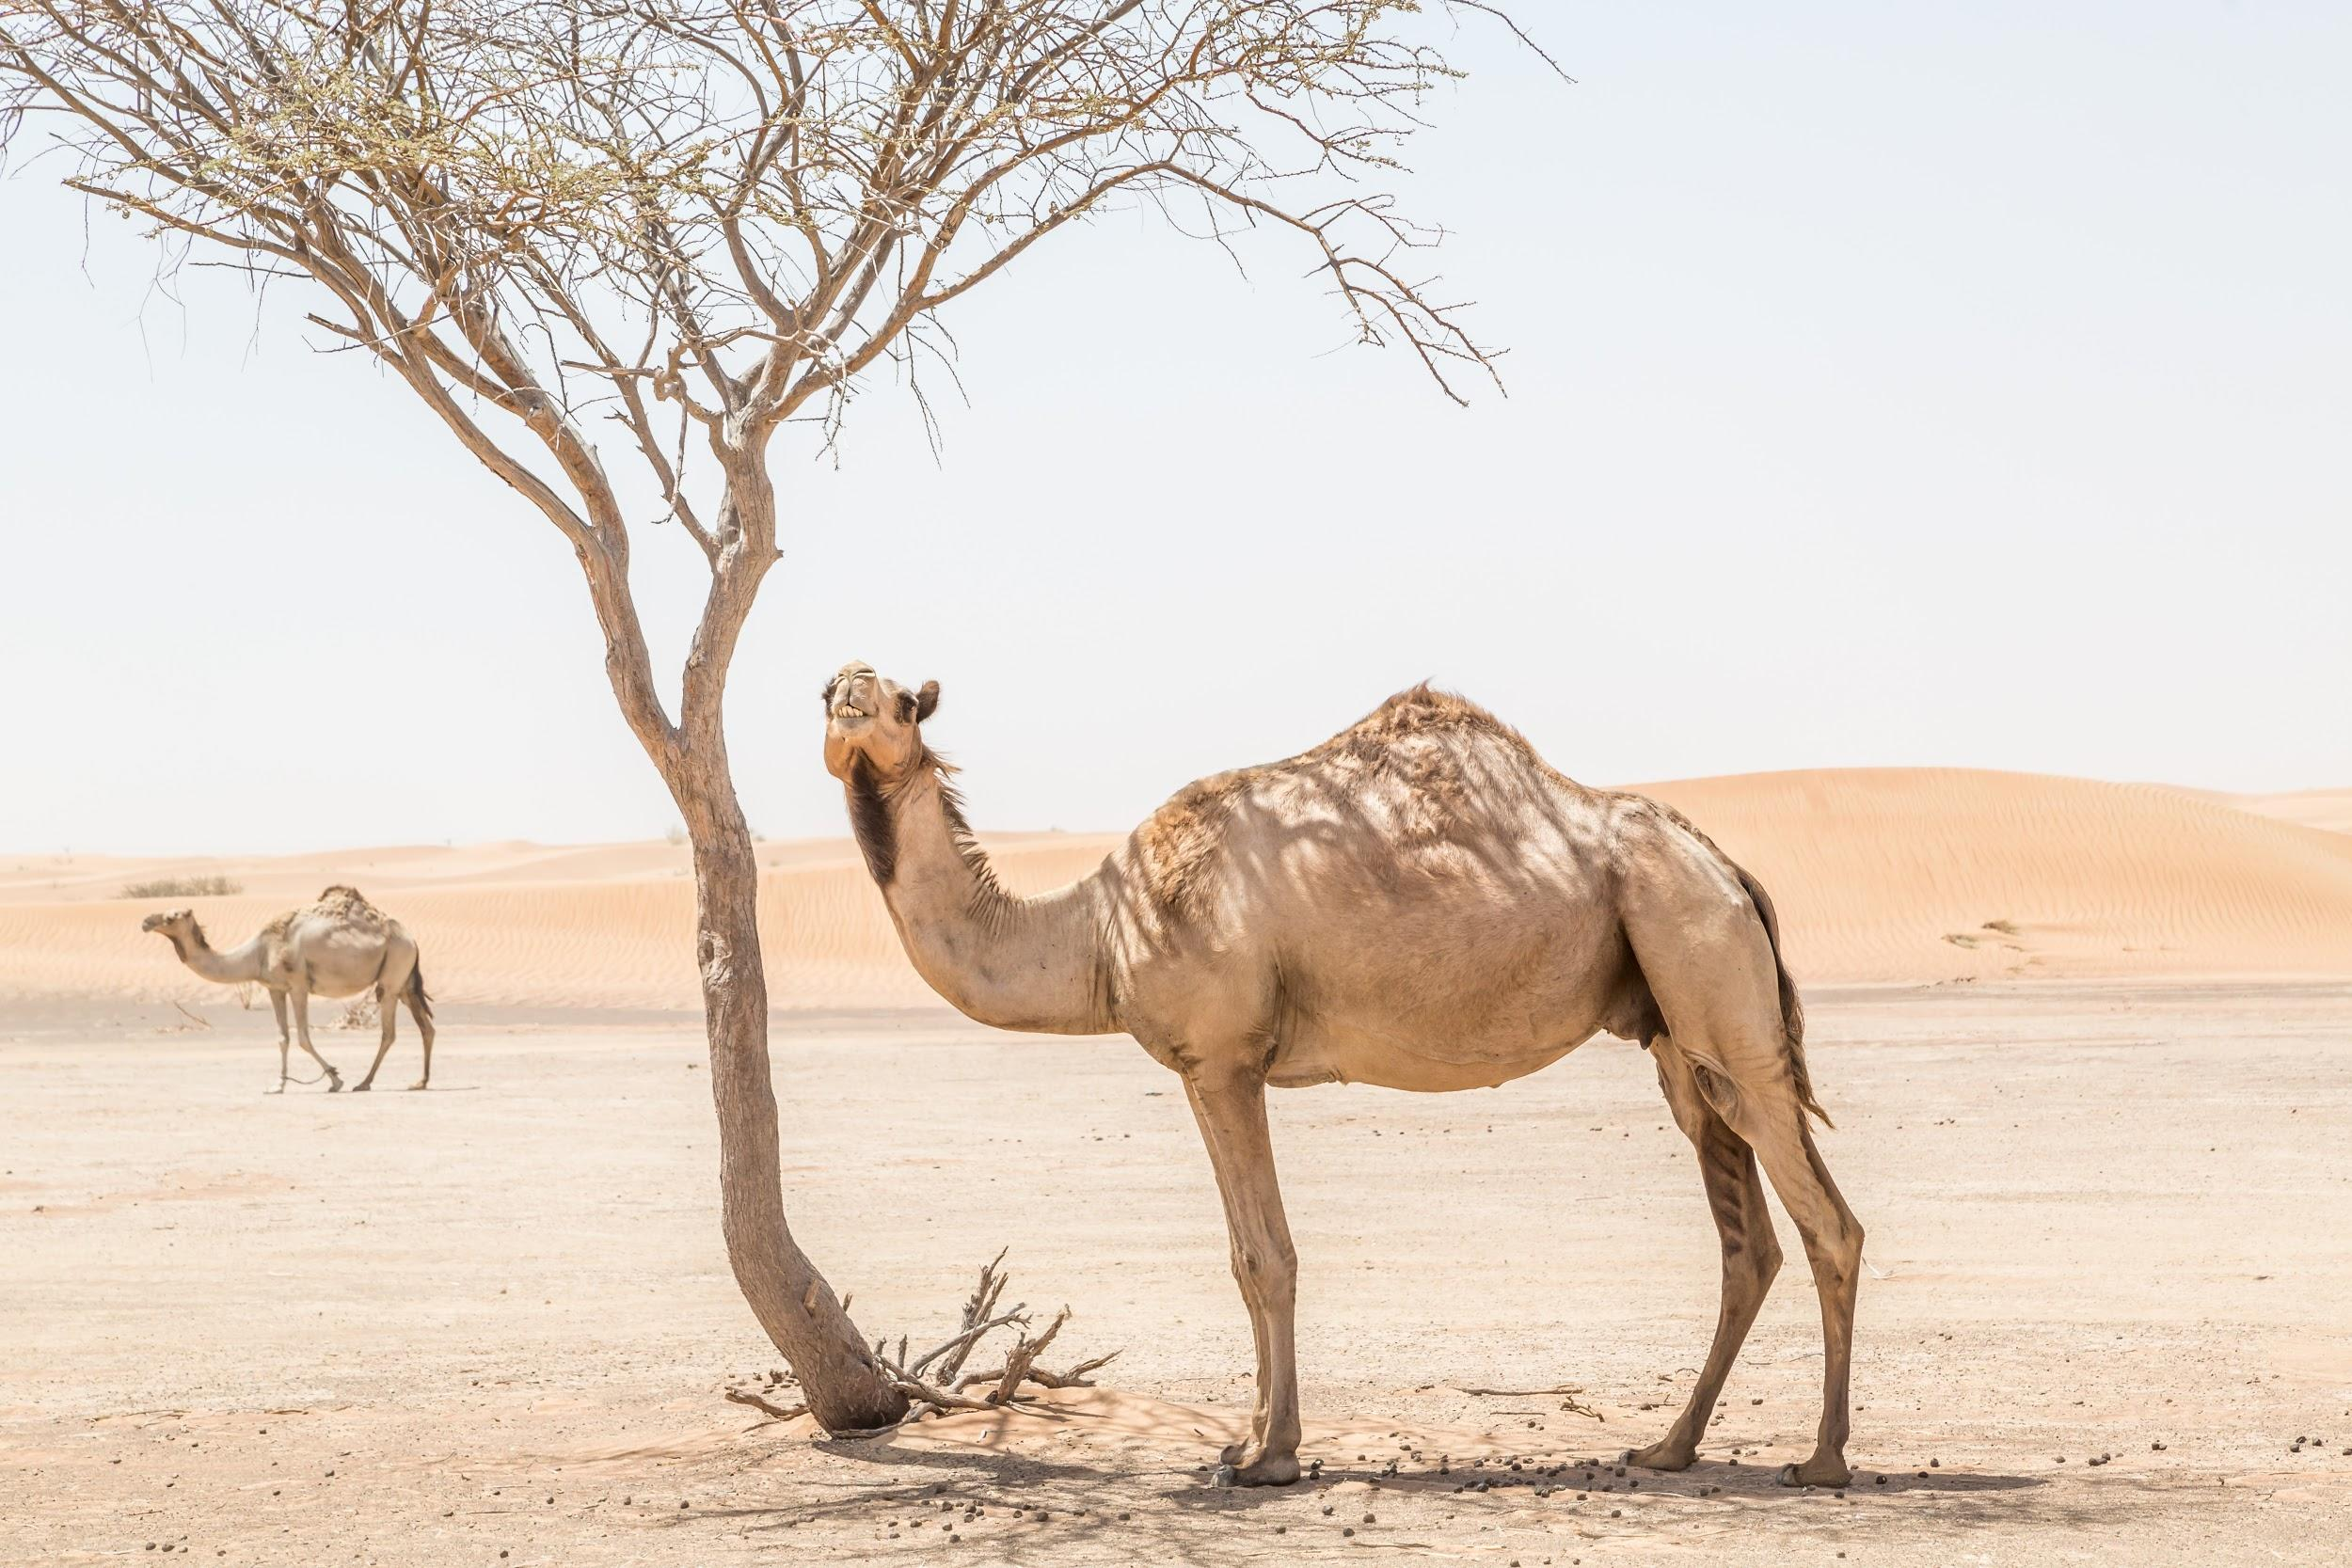
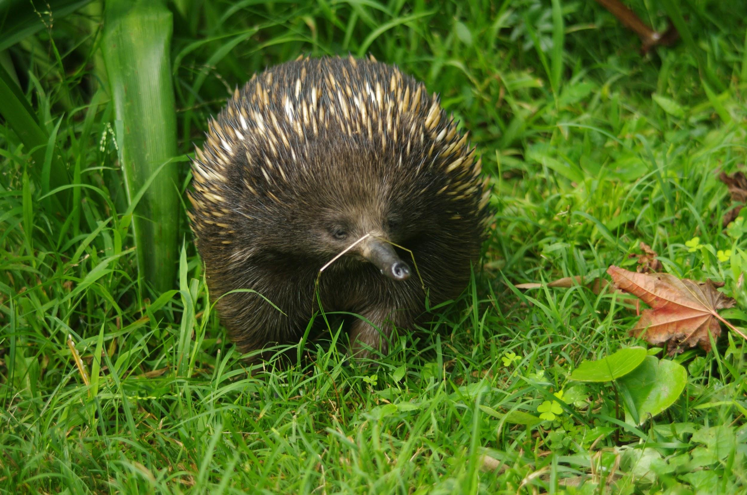
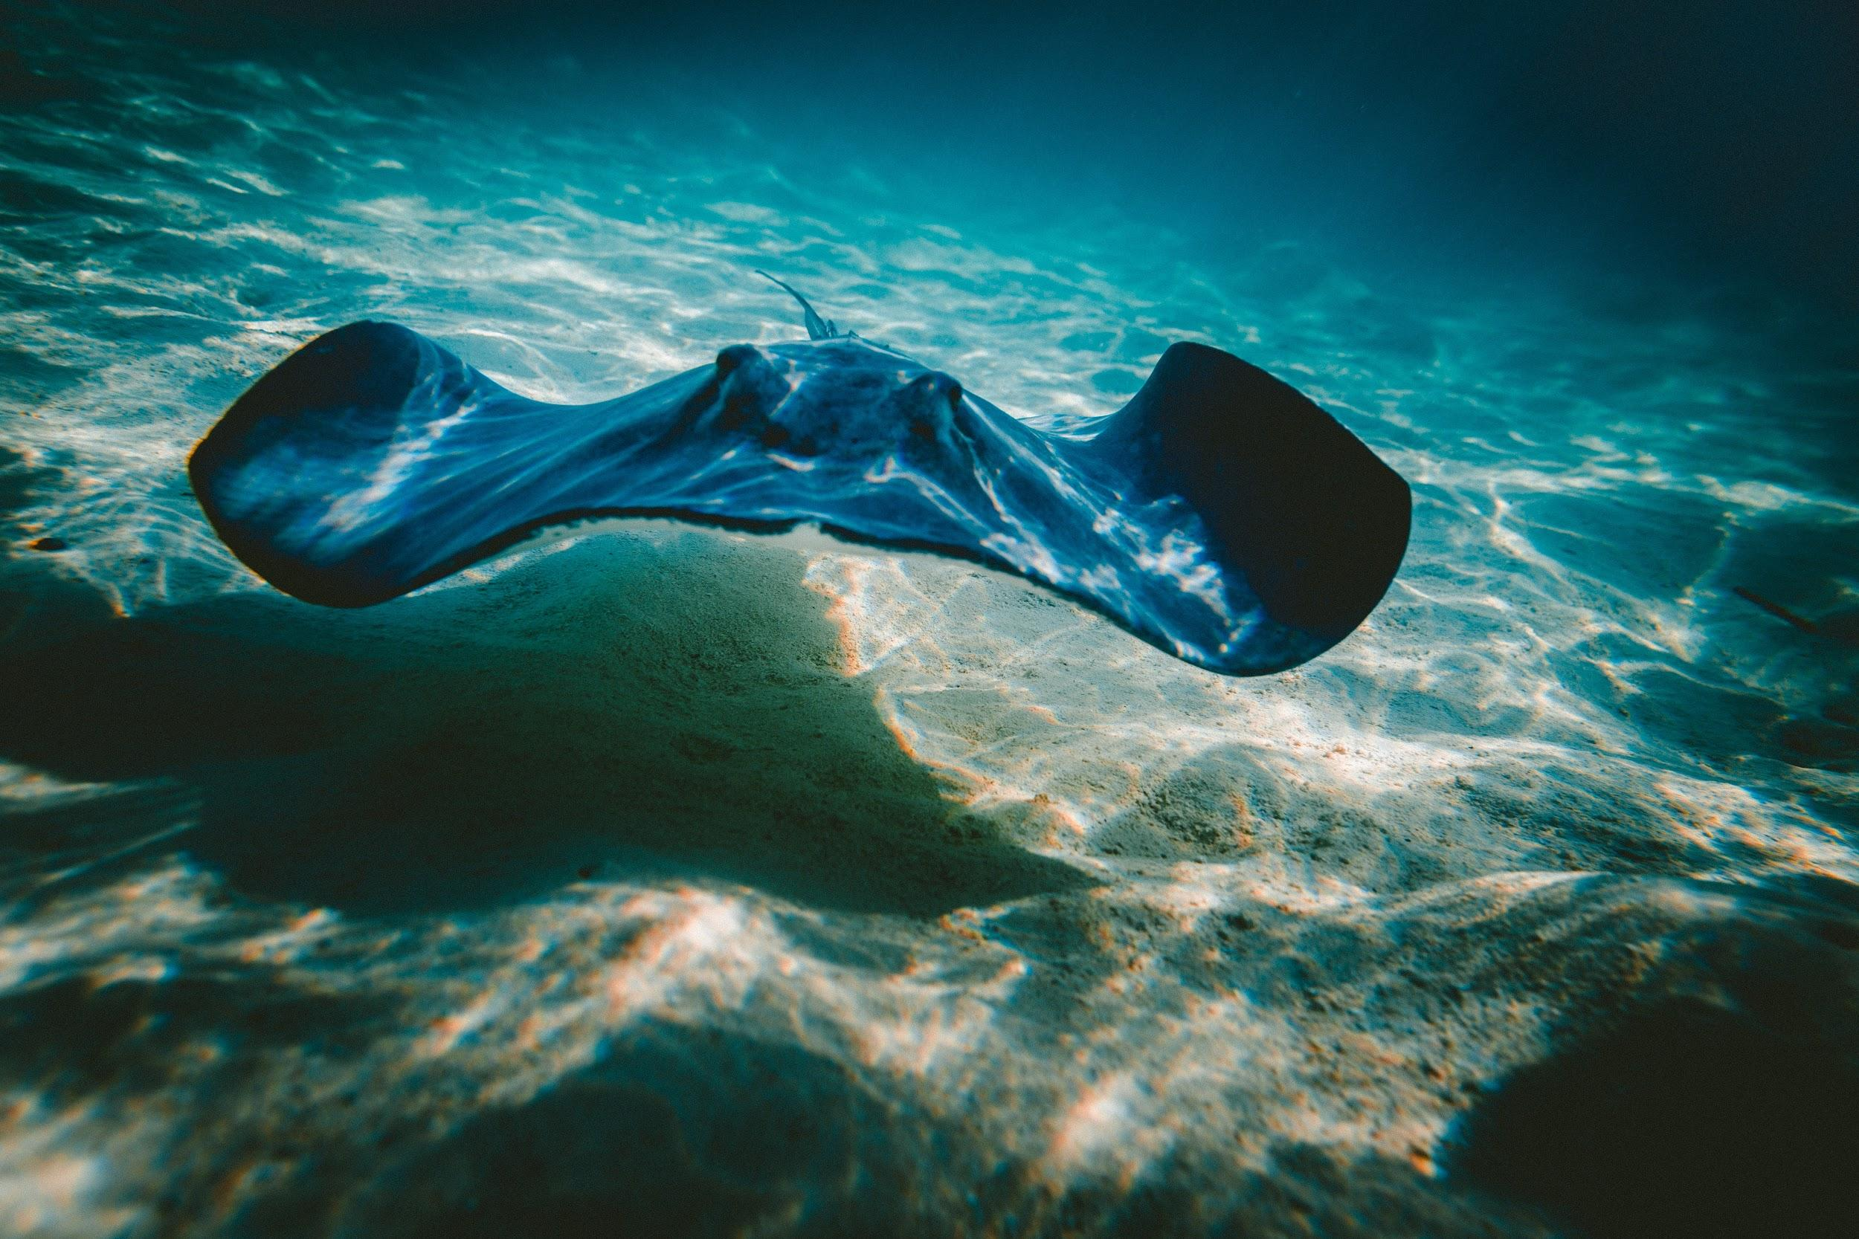
We will compare Aboriginal and Torres Strait Islander classification systems to systems used by contemporary science.
EXTENSION
What makes the emu more different to the other jirda species?
Jirda (birds) are one group of organisms classified by Aboriginal & Torres Strait Islander nations. Classify the following organisms as either jirda or not-jirda using a T-chart.
WORD-BANK
Frill-Neck - Black Swan Quokka - Pelican - Emu Koala - Kookaburra - Camel Willy Wagtail - Curlew Echidna - Sting-Ray
HINT
Students, remember that organisms are classified to link species with similar features. The more features that an organism shares, the more closely they will be related.

Slide 16
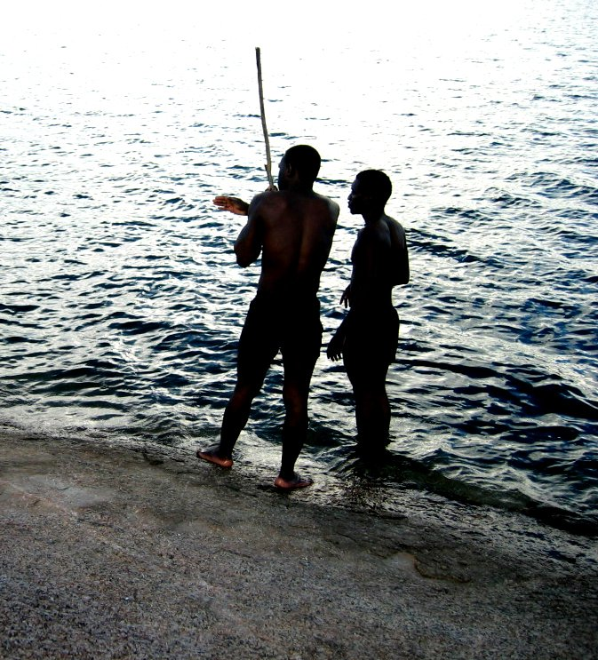
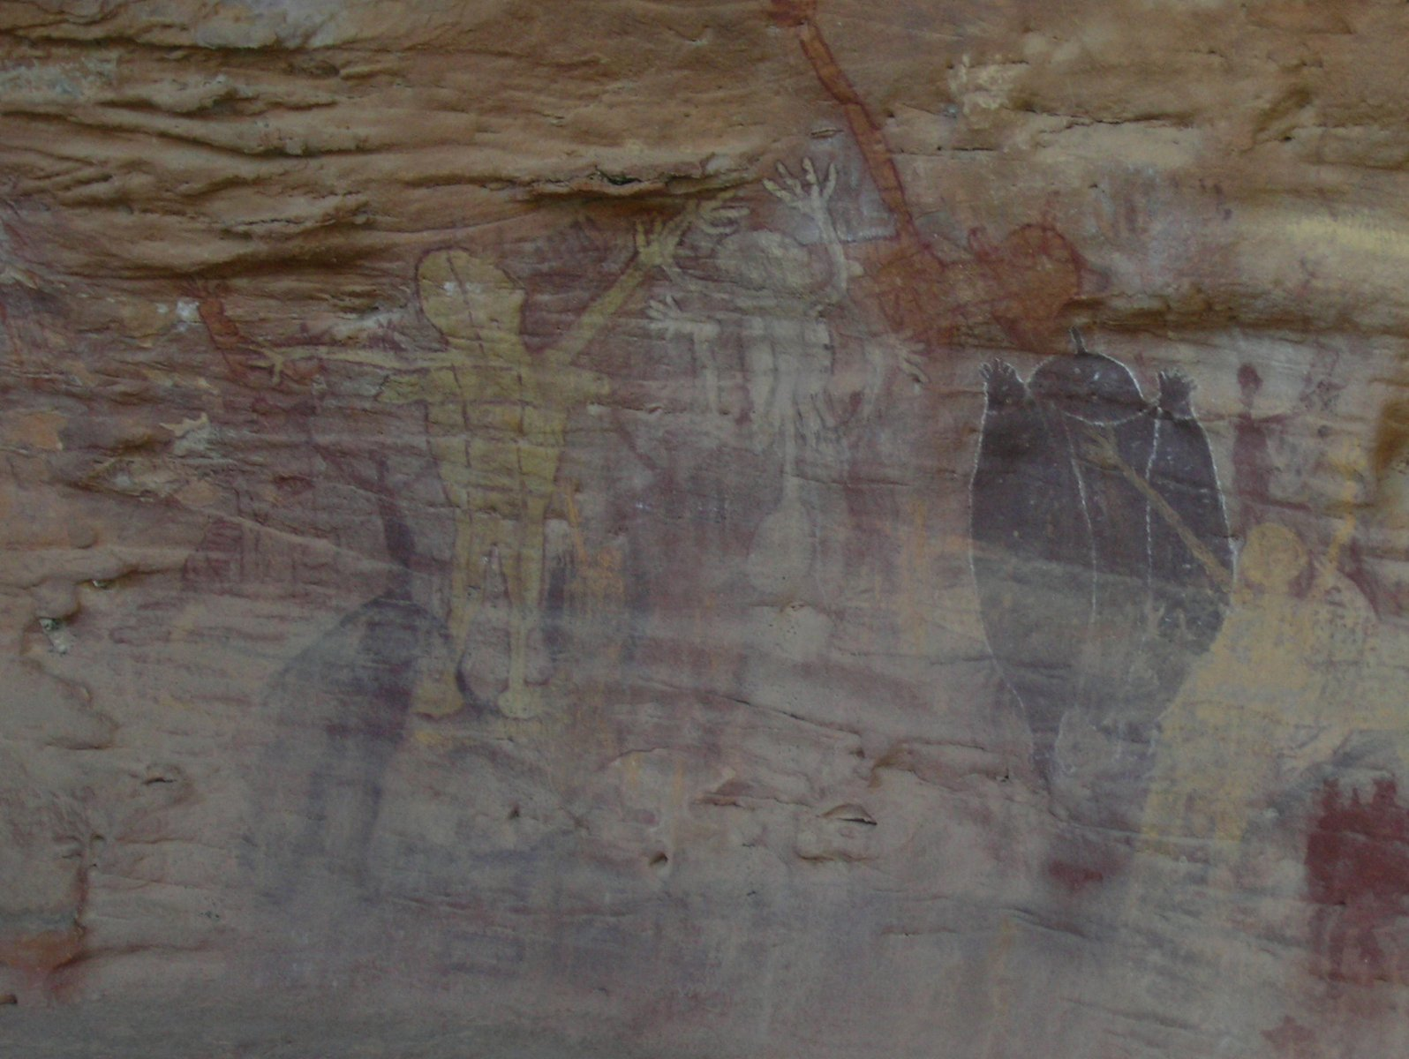
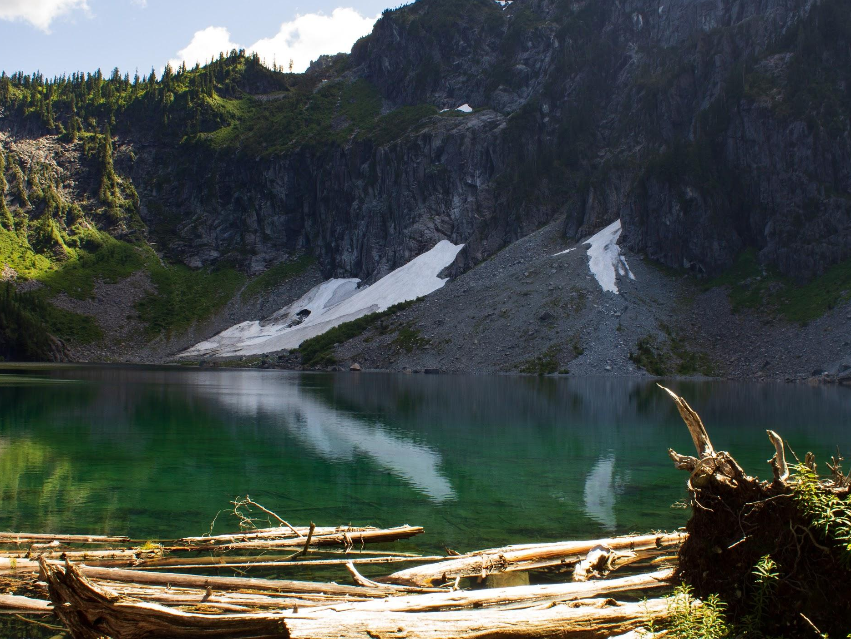
We will compare Aboriginal and Torres Strait Islander classification systems to systems used by contemporary science.
CHECK FOR UNDERSTANDING
Why are classification systems used by Aboriginal & Torres Strait Islander nations?
Aboriginal and Torres Strait Islander nations use their vast knowledge around for living things such as edible and inedible plants or medicinal₁ plants.
This knowledge is extended for when these organisms are no longer living. This includes categorising trees as spear trees, string trees, shield trees, canoe trees, resin trees and many more.
VOCABULARY
1 - used for medicine.

Slide 17
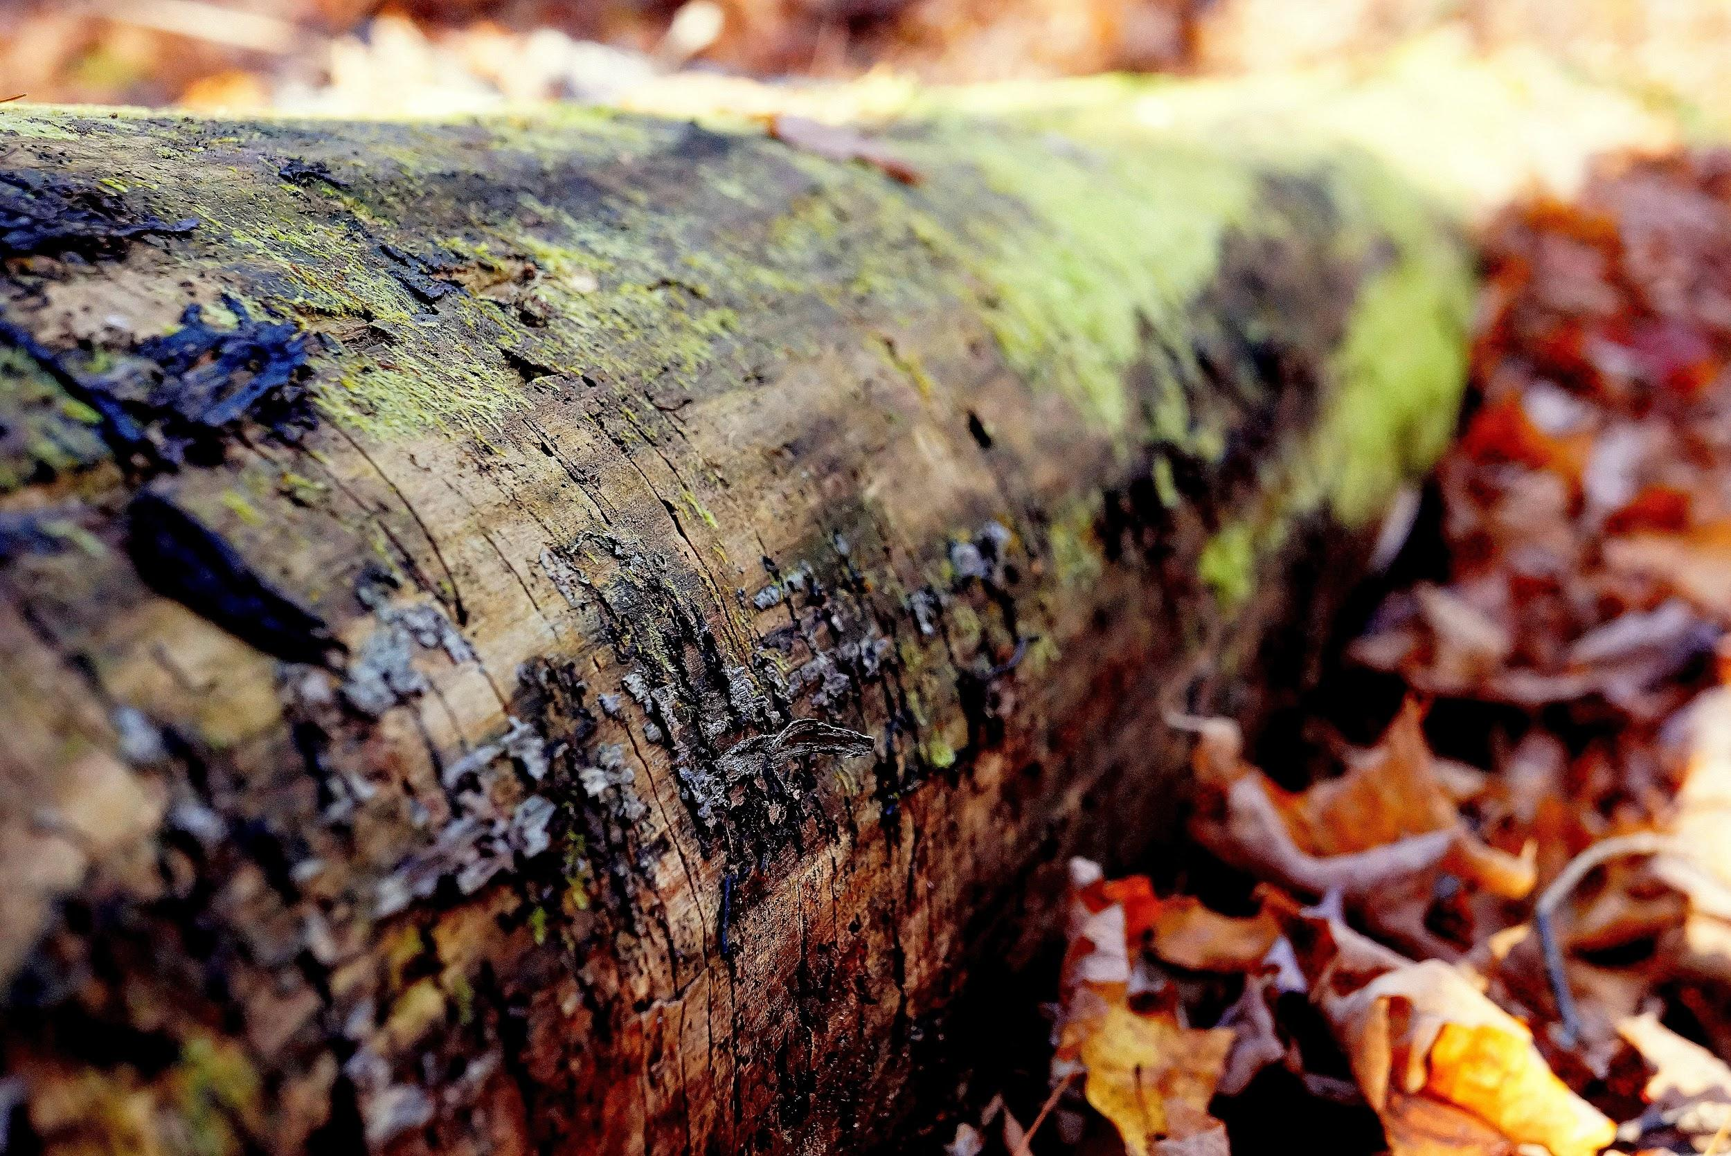
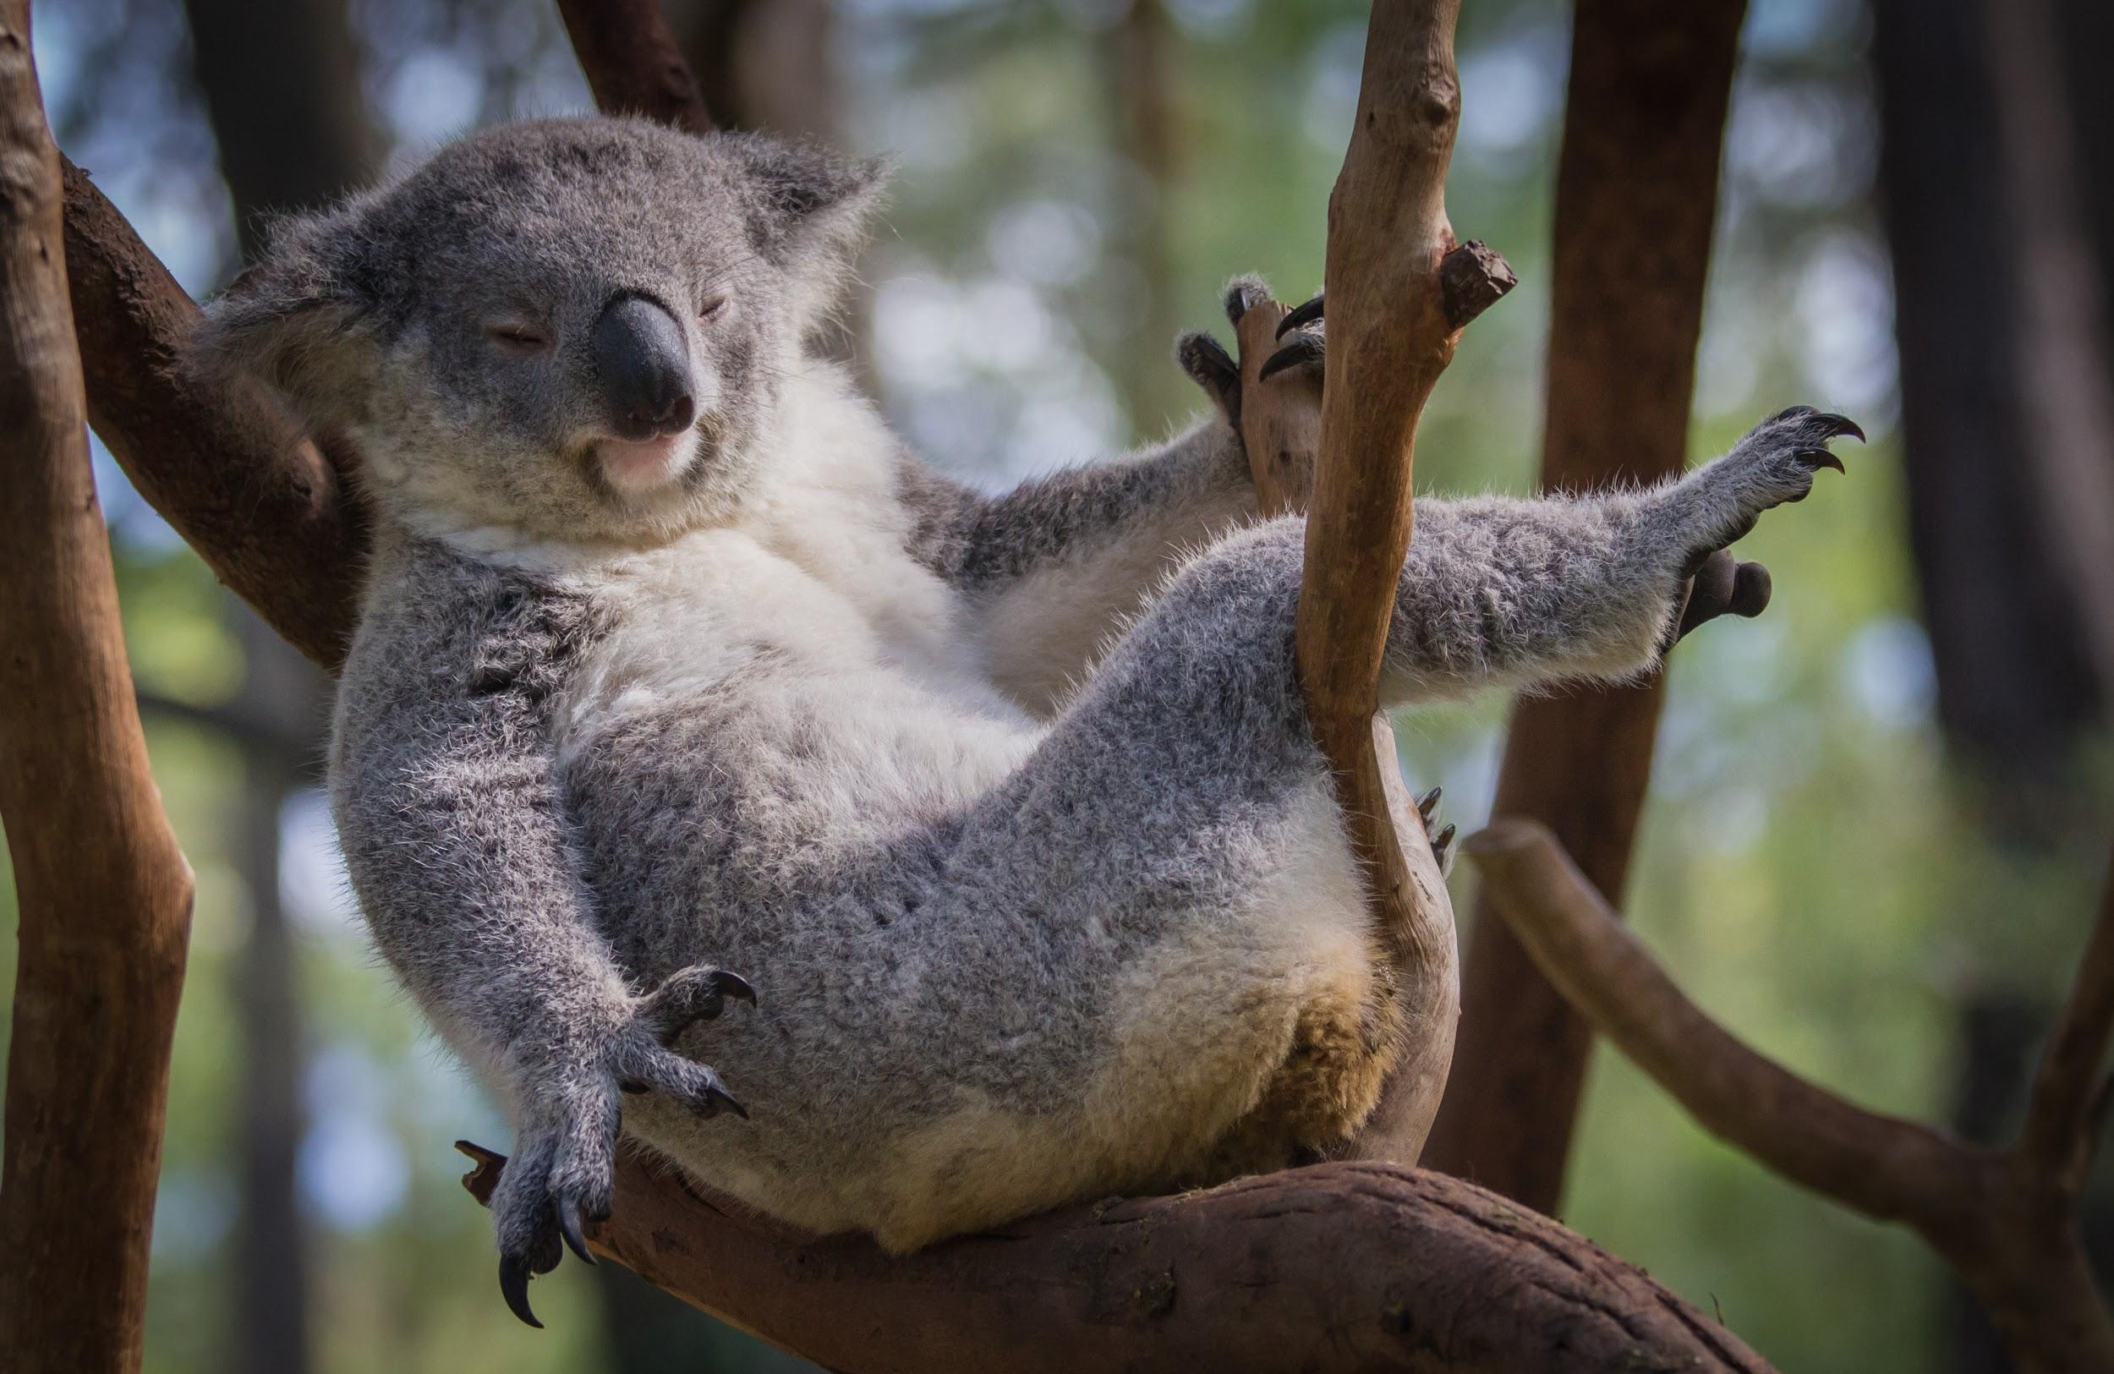
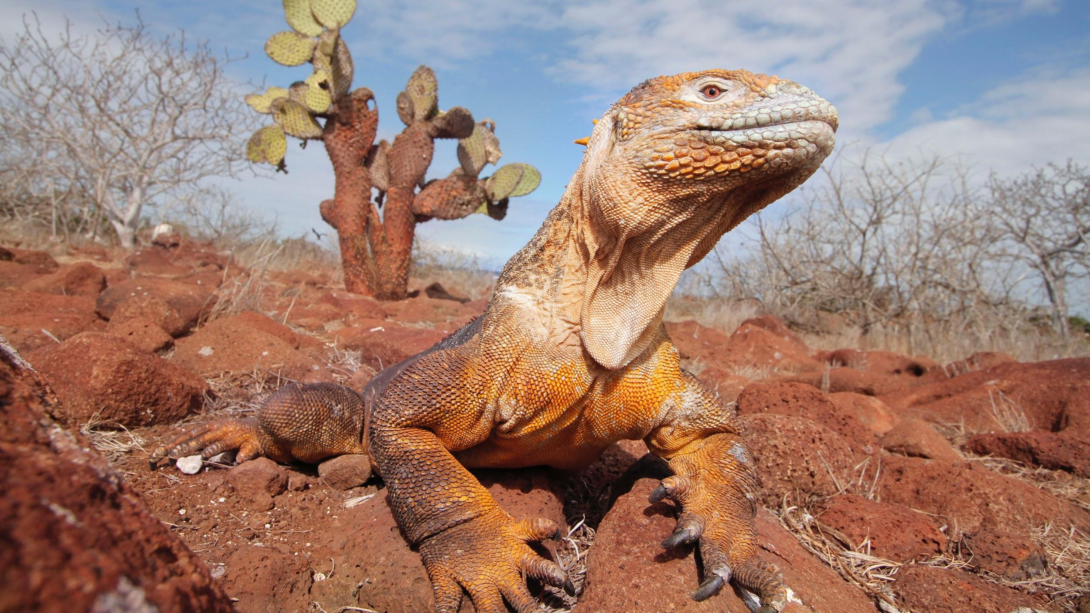
We will compare Aboriginal and Torres Strait Islander classification systems to systems used by contemporary science.
CHECK FOR UNDERSTANDING
Provide an example of how Indigenous nations might categorise some organisms differently to Linnaean classifications.
Aboriginal and Torres Strait Islander nations use classification systems to group different organisms based on their uses or cultural significance.
Binary₁ classifications are used to identify organisms as edible or inedible, totemic or non-totemic.
Indigenous classifications differ from Linnaean classifications as organisms were commonly categorised on their use rather than their similarities.
VOCABULARY
1 - two options, it does have or it does not have

Slide 18
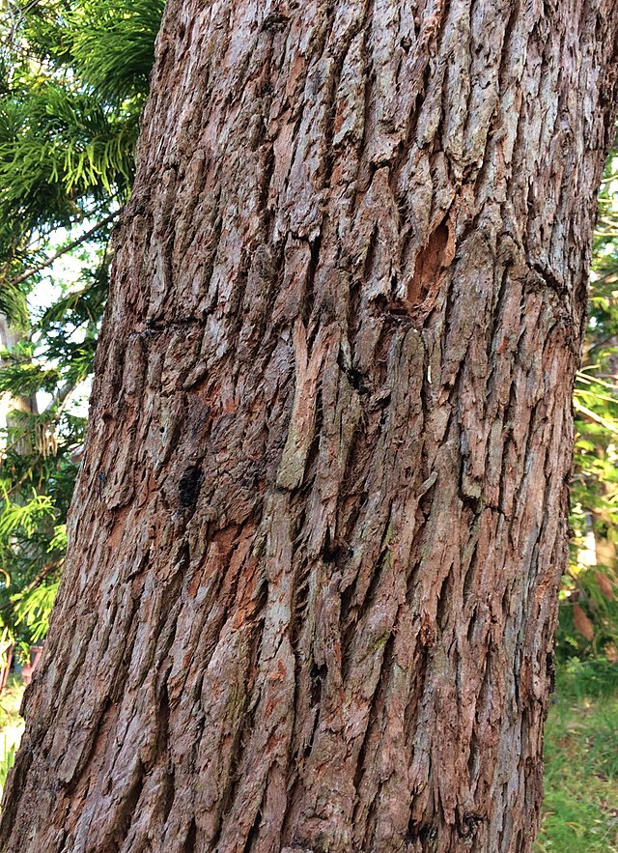
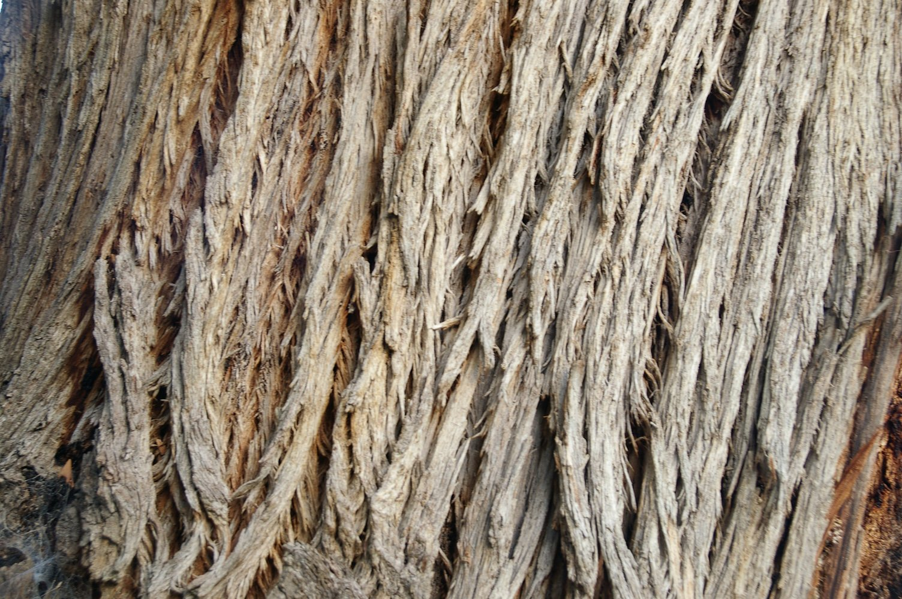
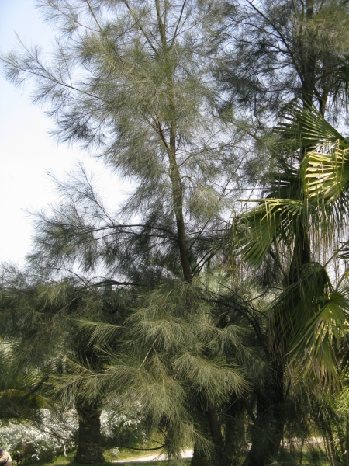
We will compare Aboriginal and Torres Strait Islander classification systems to systems used by contemporary science.
Answer the questions below in your workbooks.
Classify the plants below based on the following uses: crafting canoes, shields or spears. This is a research task.
HINT
Indigenous classification categorises organisms based on their uses. For example, canoes are made out of the loose bark of trees, shields are crafted from broad trees, and spears are created from trees with hardwood.
Why do Aboriginal and Torres Strait Islander nations classify organisms?
How does Indigenous classification differ from Linnaean classification?
Bangalay
Stringybark
Sheoak
Notes:
Bangalay - canoes
Stingybark - canoes and shields
Sheoak - shields

Slide 19
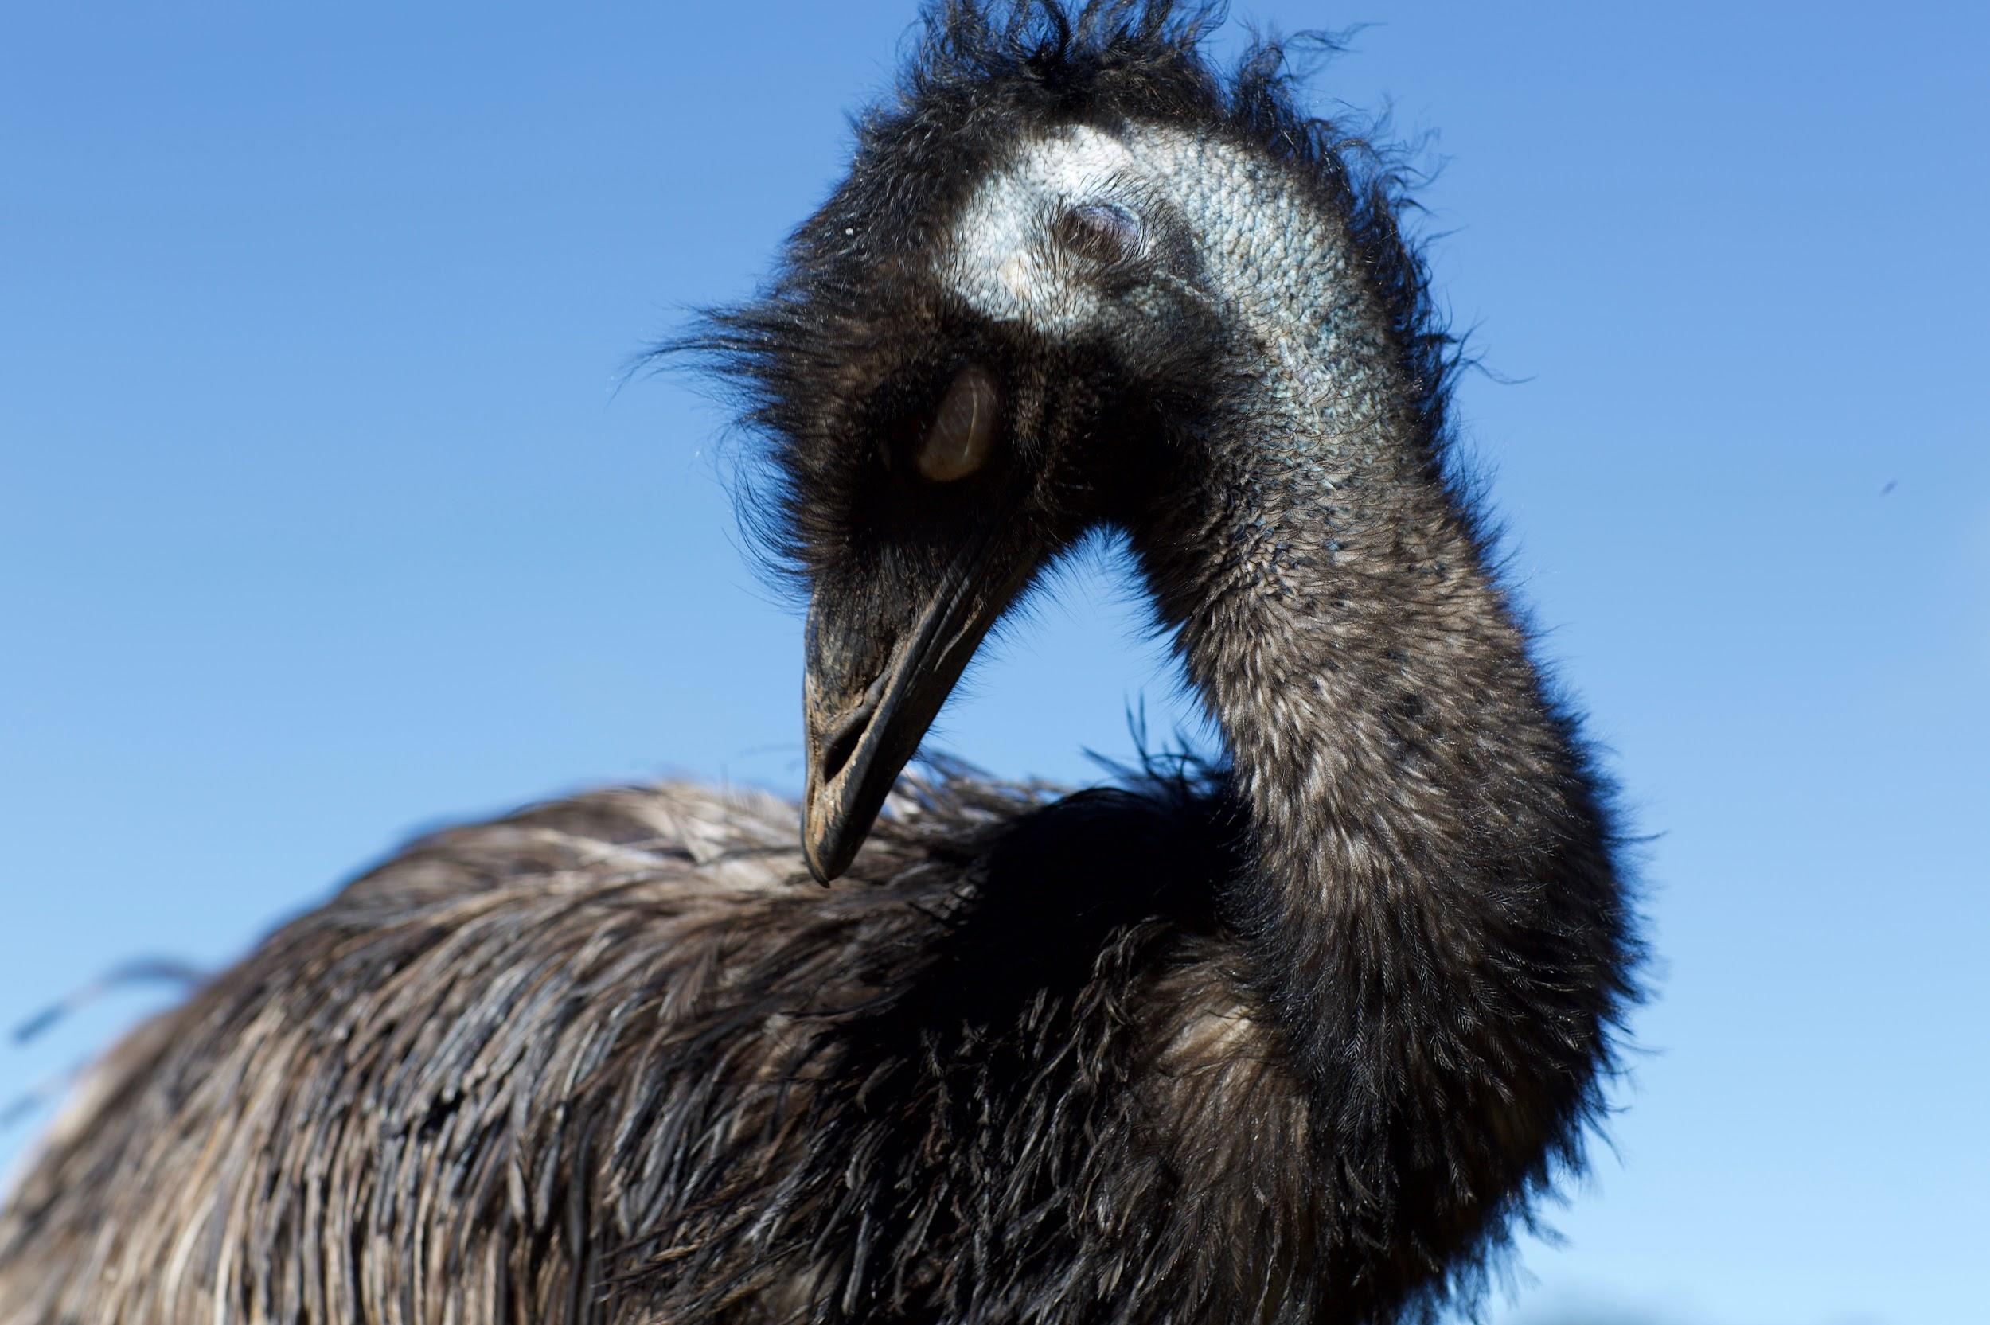
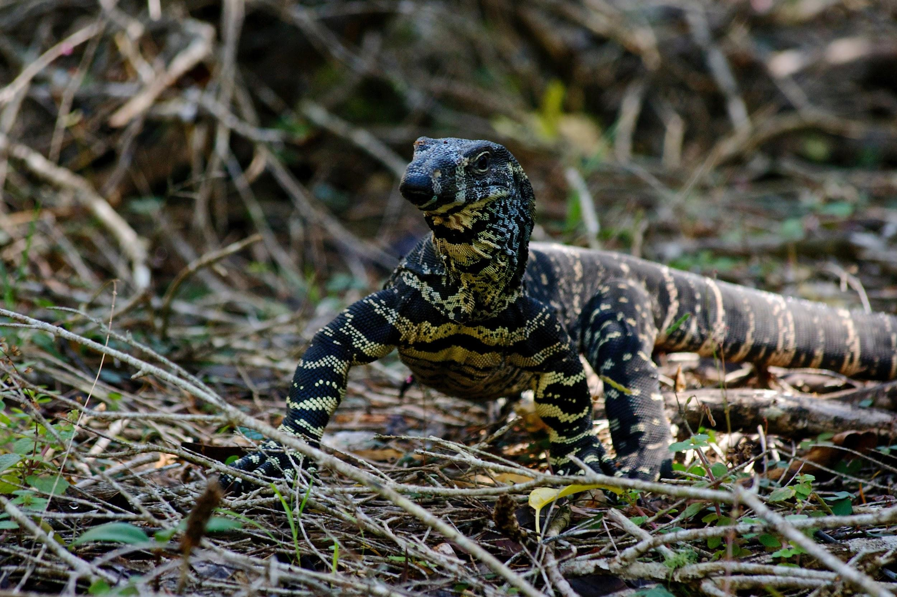
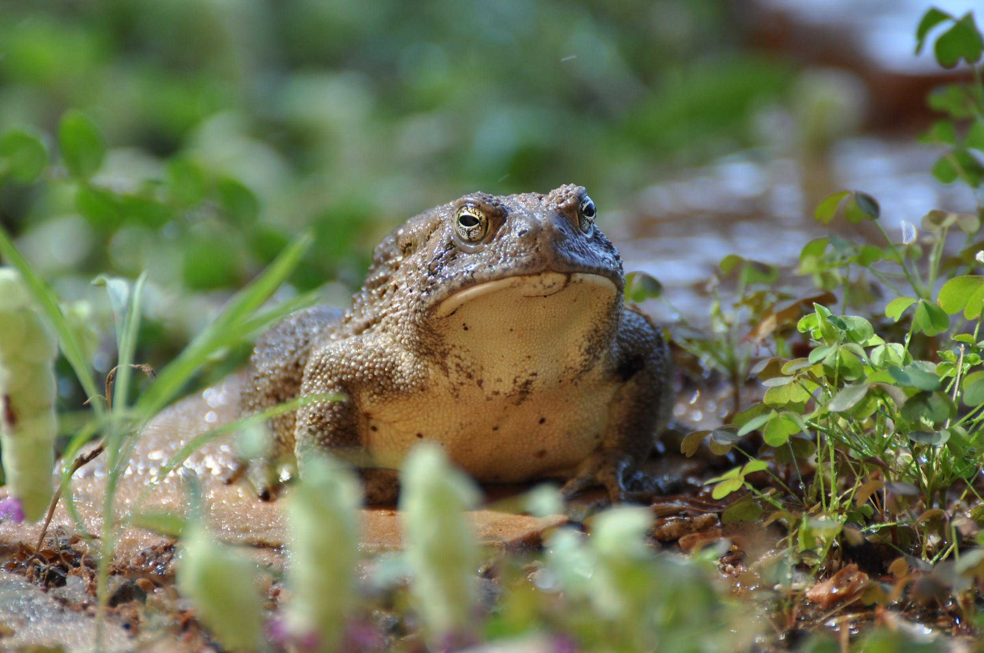
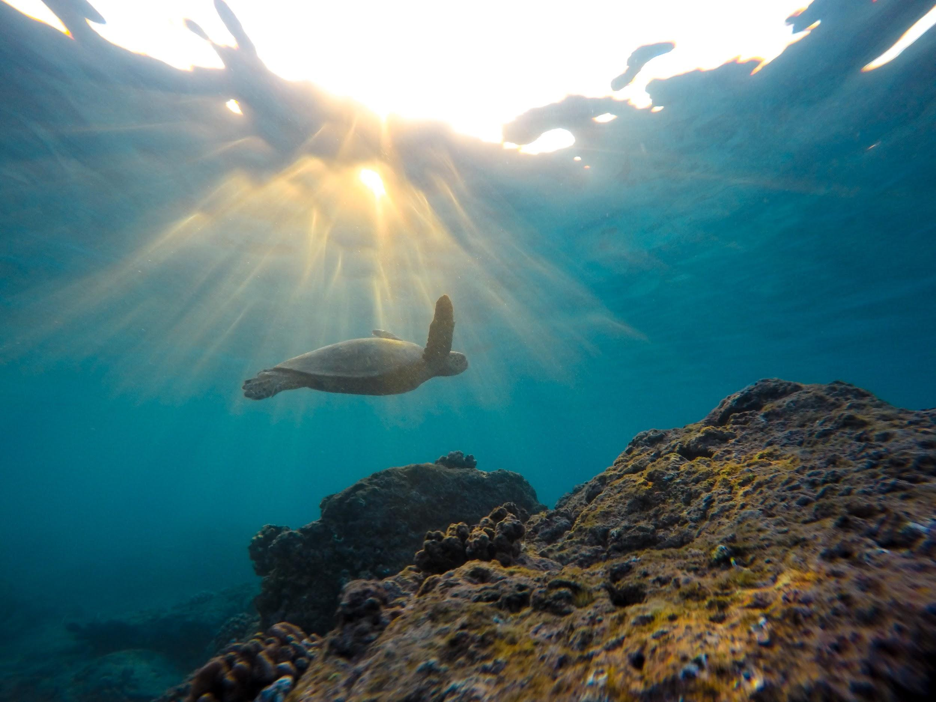
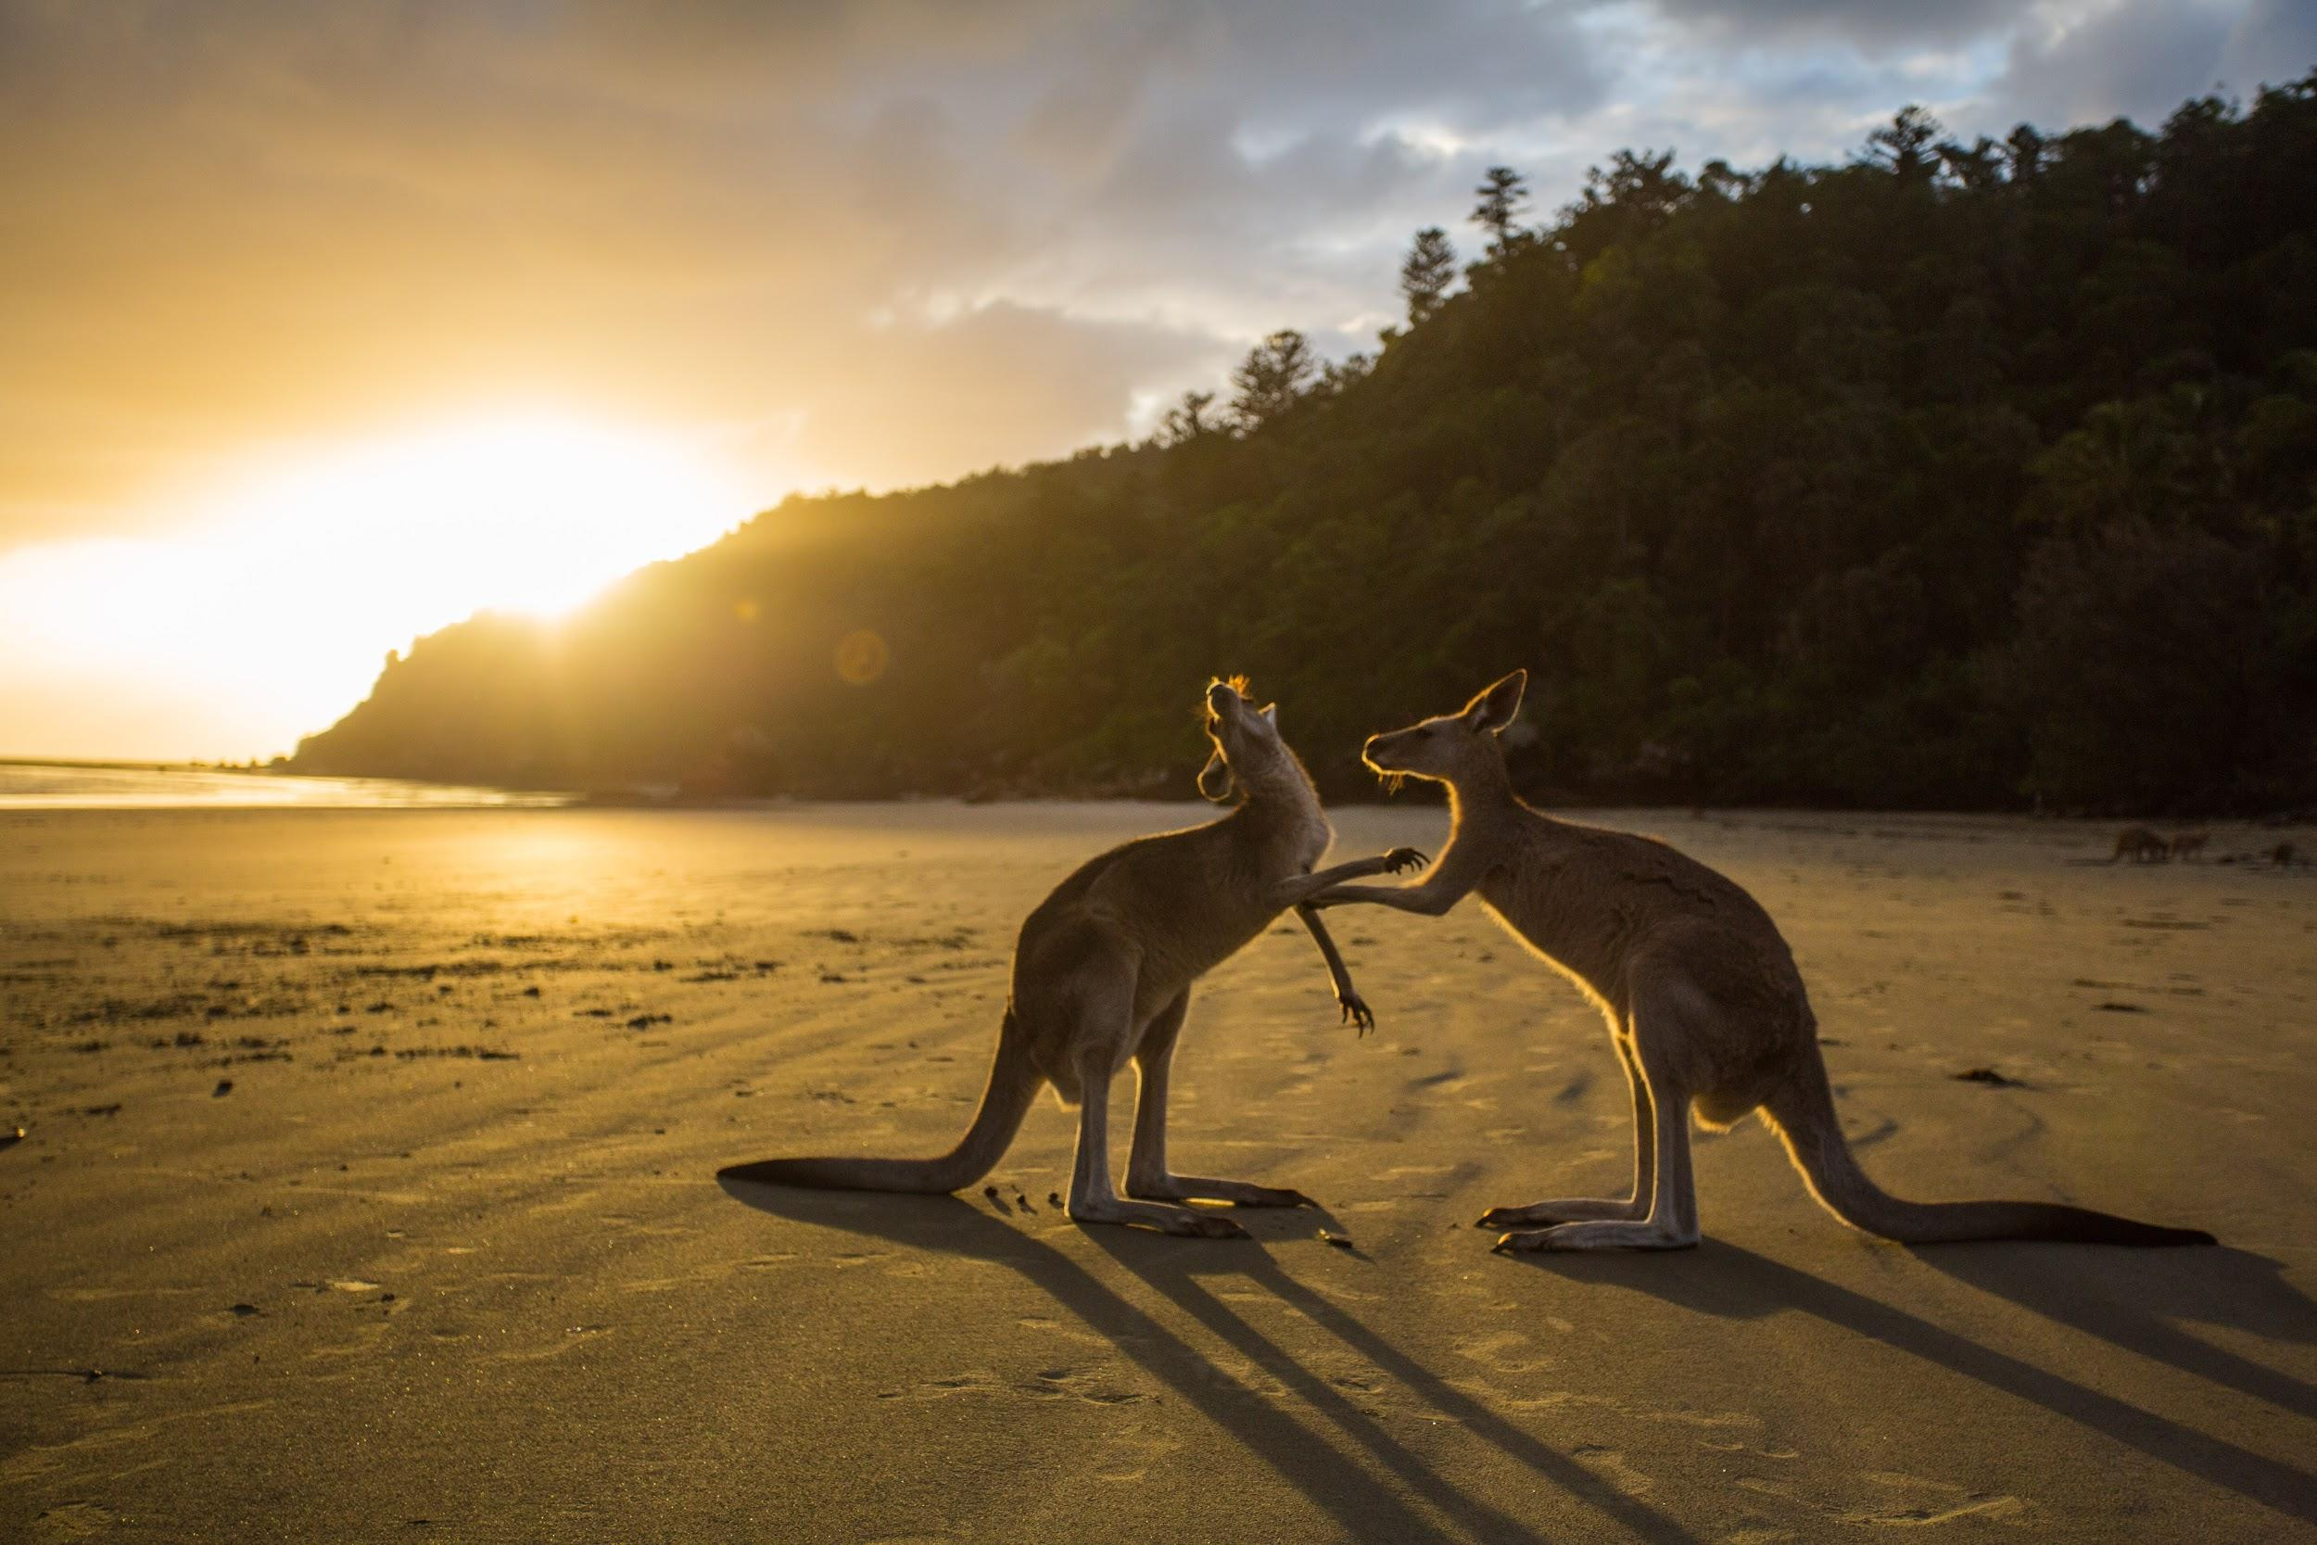
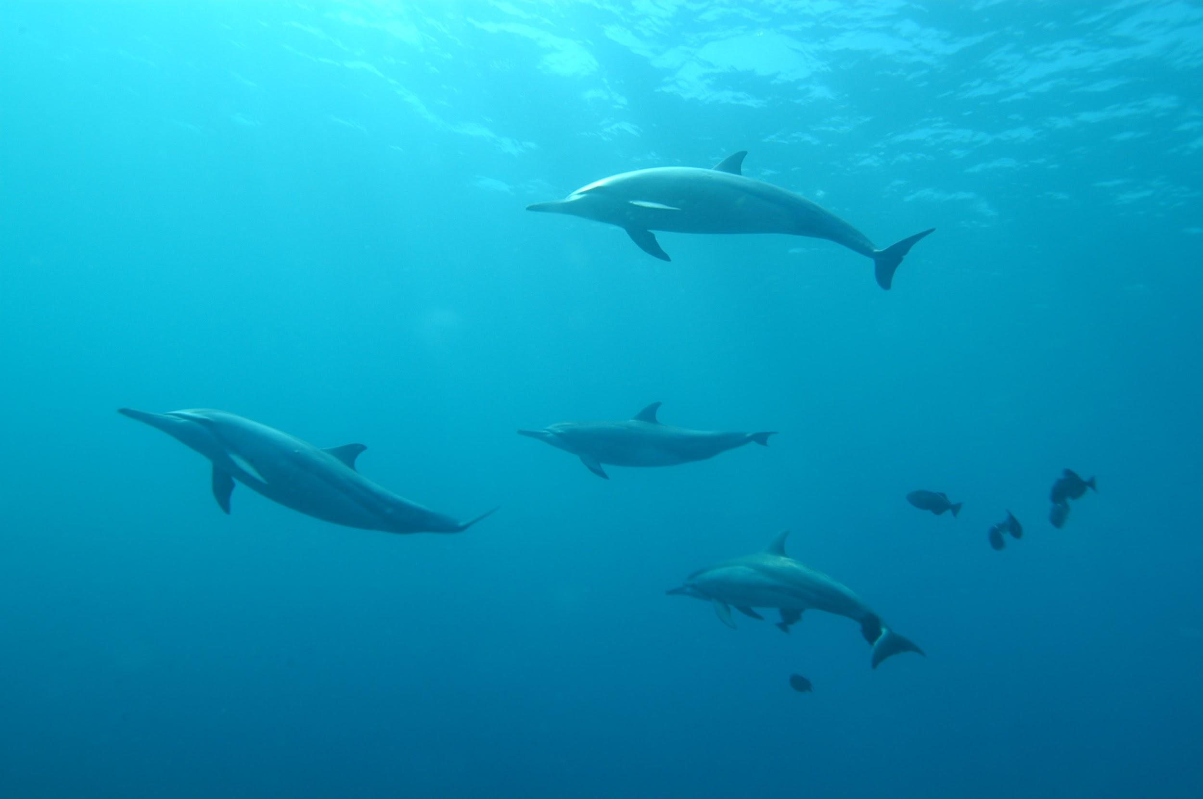
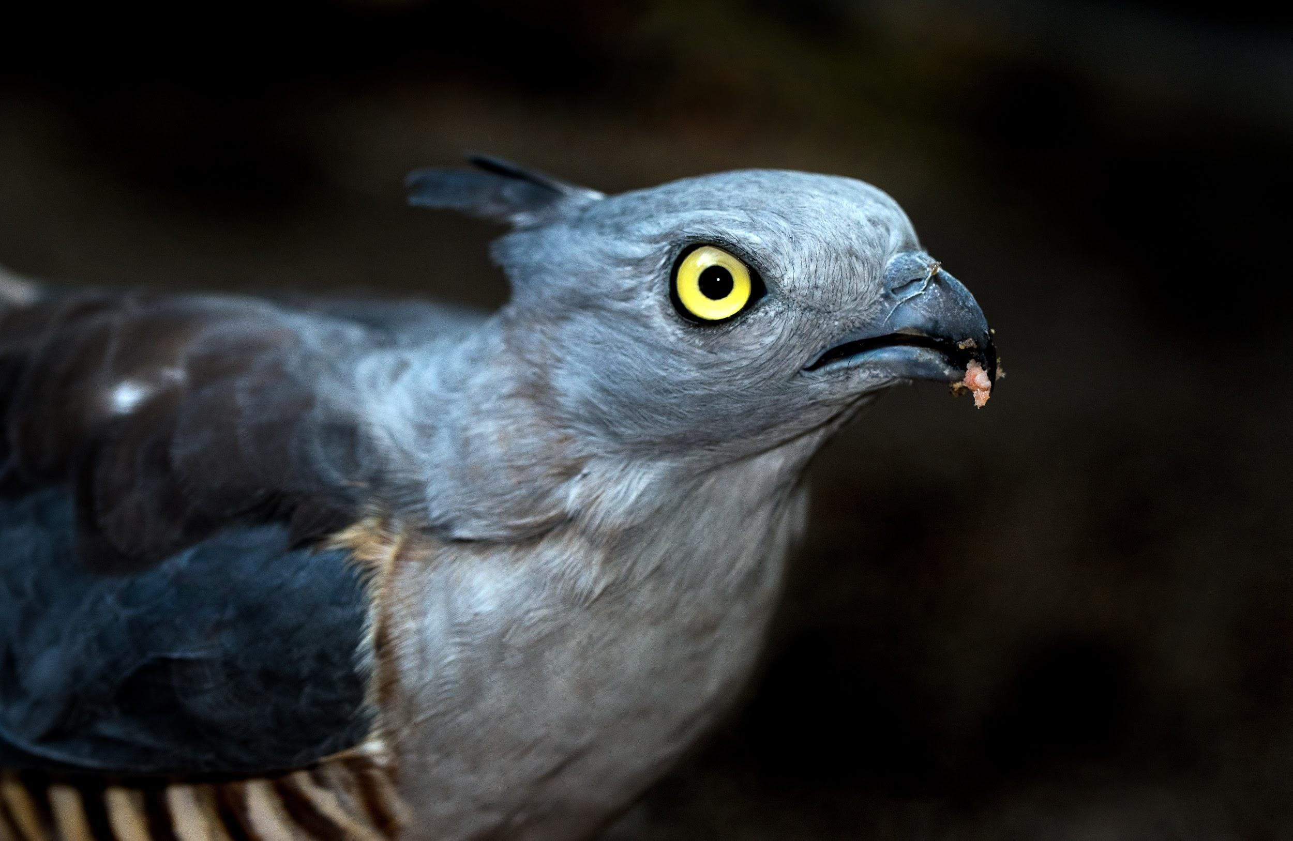
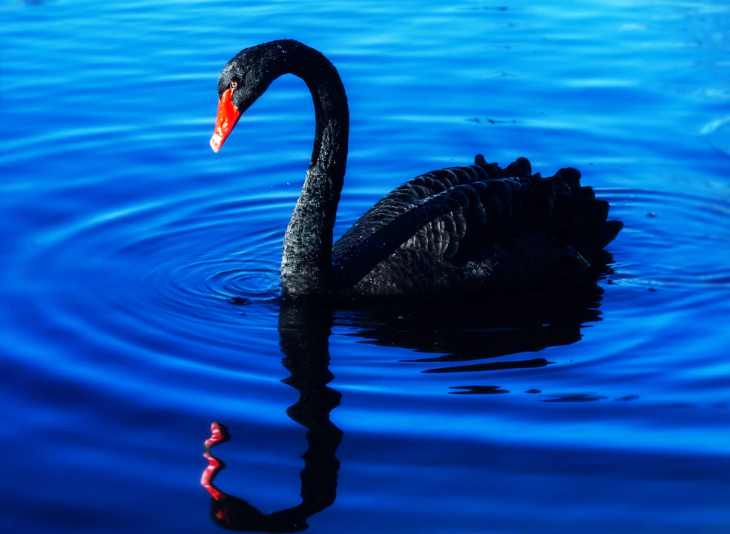
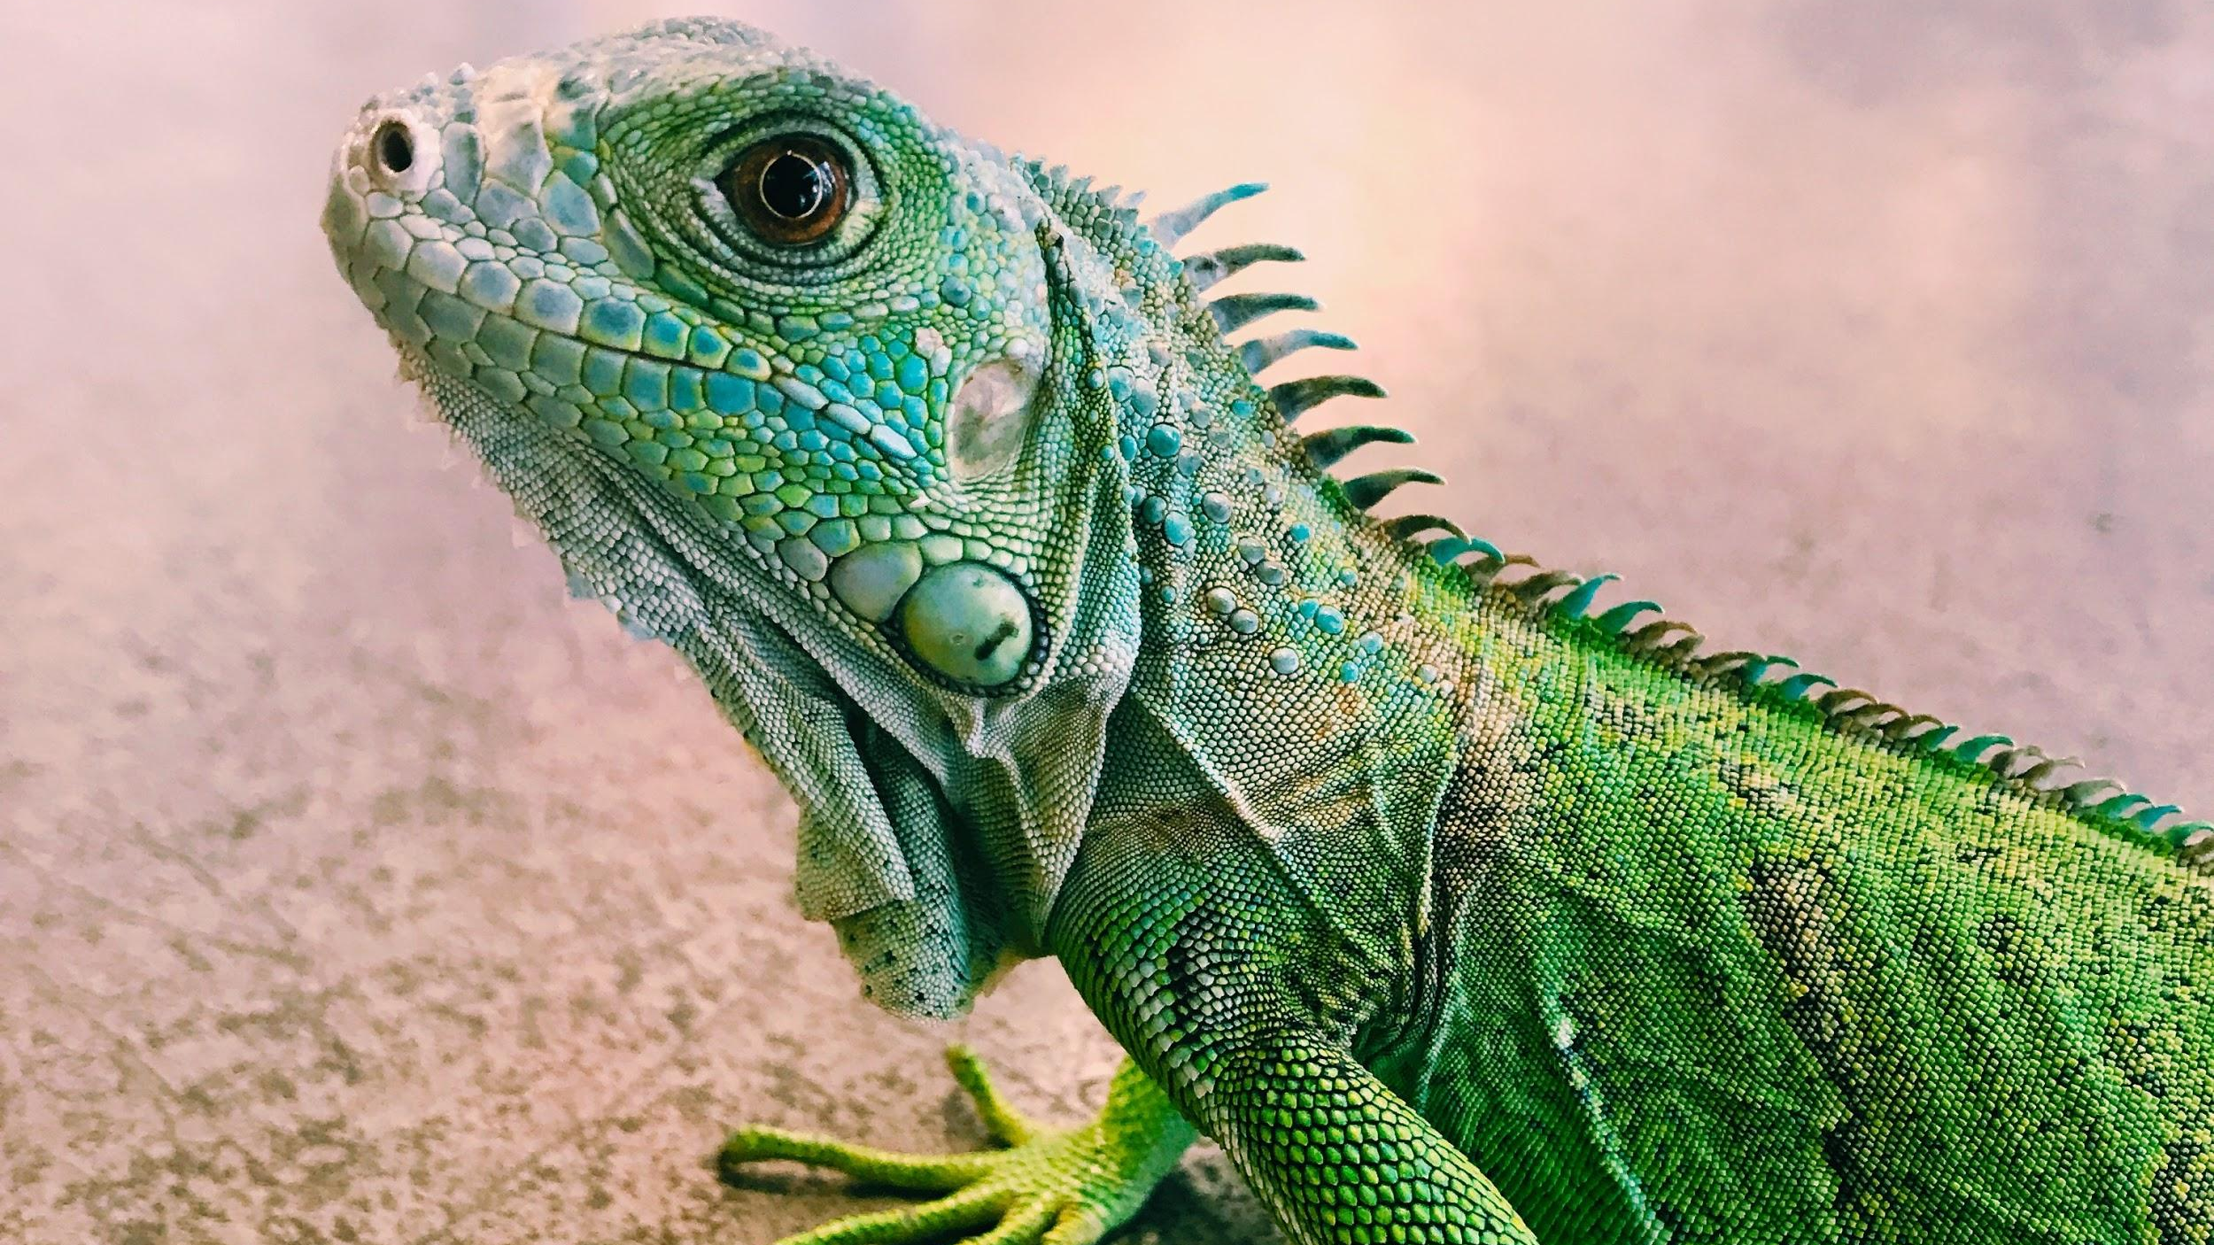
We will compare Aboriginal and Torres Strait Islander classification systems to systems used by contemporary science.
EXTENSION
Using your laptops, research the Linnaean classification of the organisms below.
Create a T-chart to match the common names with their Whadjuk Noongar names.
HINT
Students, remember that organisms are classified to link species with similar features. The more features that an organism shares, the more closely they will be related.
Weitj
Yoorn
Kwooyar
Yarkan
Yonga
Kip
Waalitj
Maali
Kulari
Notes:
Please include tasks/questions here rather than just referring to a worksheet. This will save on photocopying and facilitate sharing with other schools.
Try and build tasks/questions which escalate through Bloom’s Taxonomy. This will help with differentiation.

Slide 20
We will compare Aboriginal and Torres Strait Islander classification systems to systems used by contemporary science.
We will examine the approach and purpose of Aboriginal and Torres Strait Islander classification systems.
We will use examples of organisms and compare their classification between Aboriginal and Torres Strait Islander and contemporary science classification systems.
CHECK FOR UNDERSTANDING
Check Success Criteria.

